Slide 1
IMI impact on:
Vaccines
10 November 2023

Slide 2
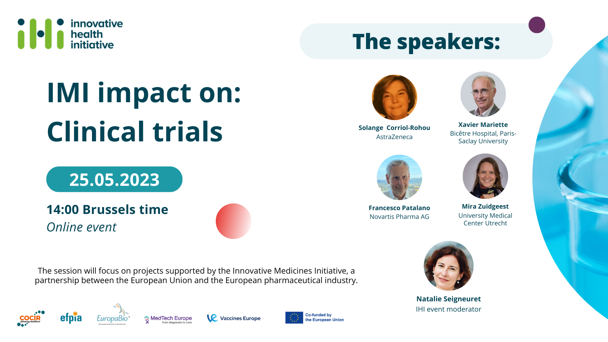
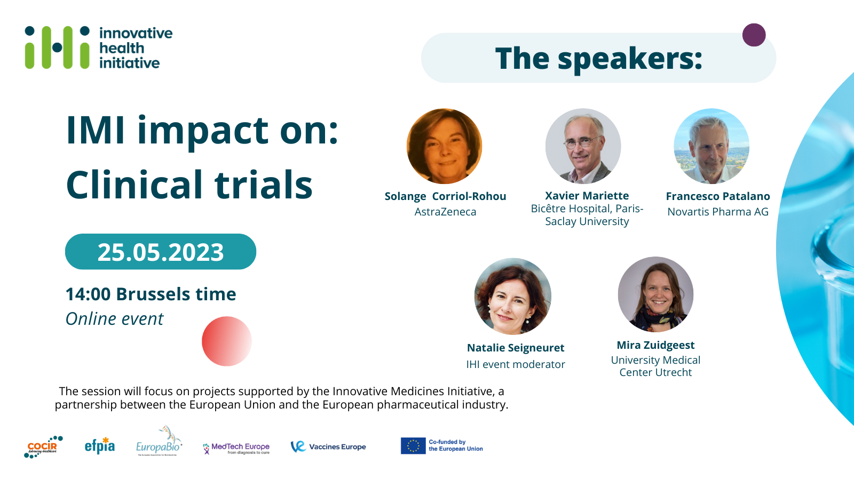
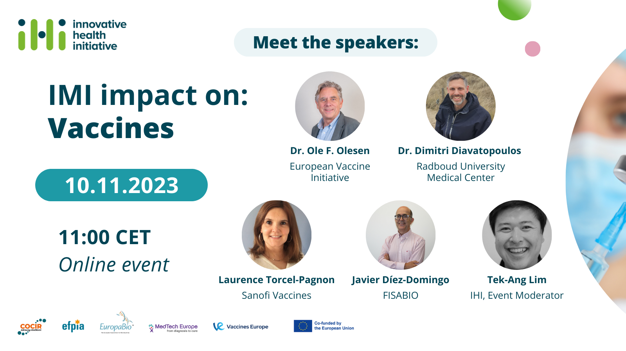

Slide 3
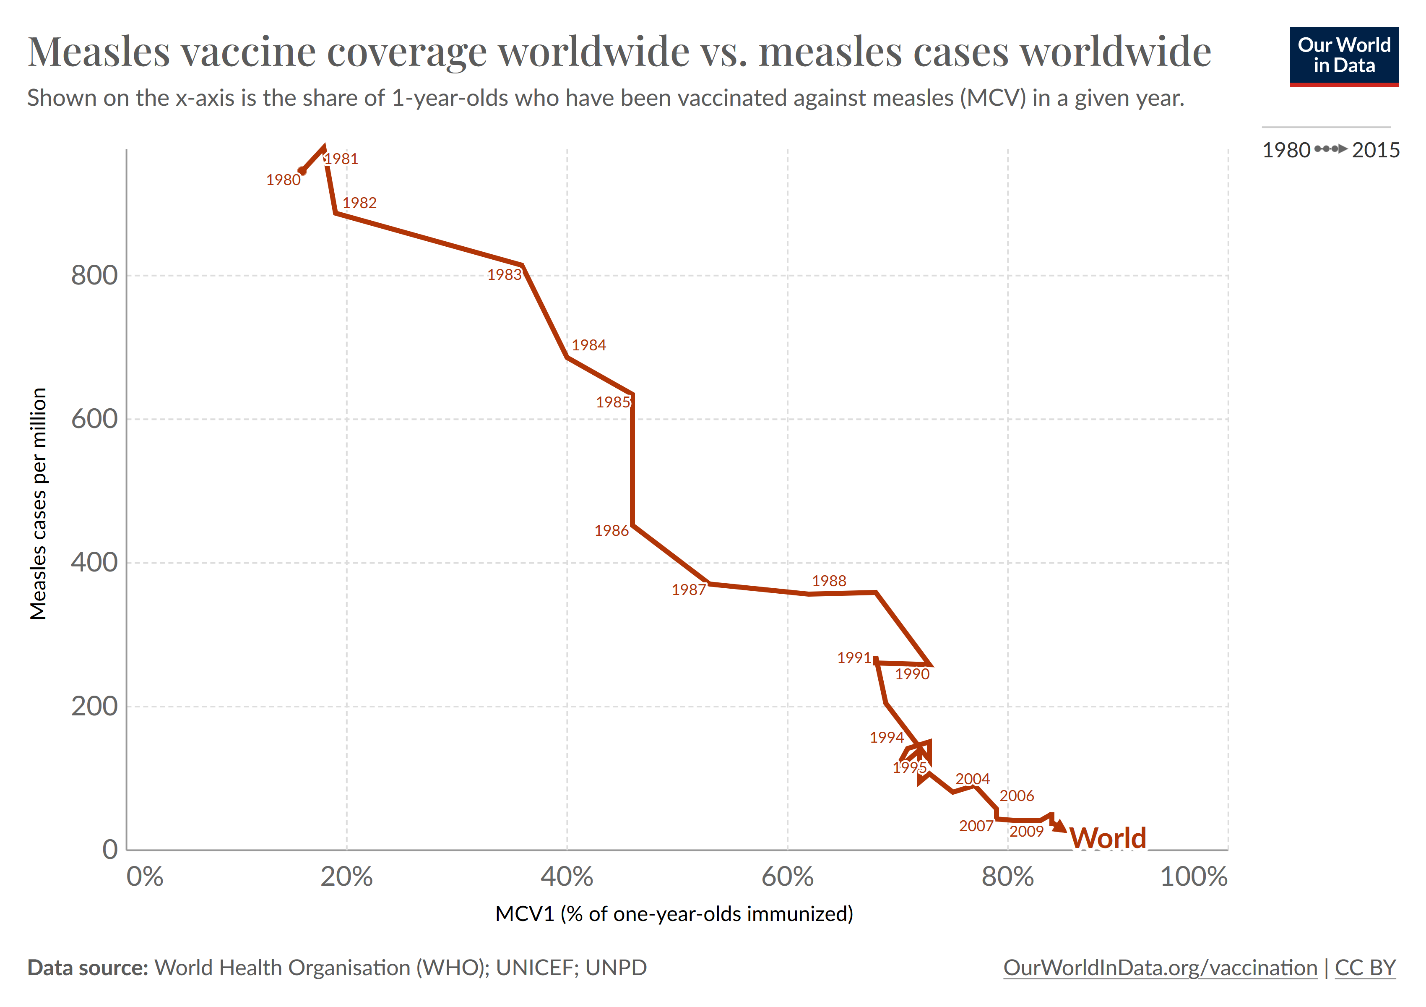

Slide 4
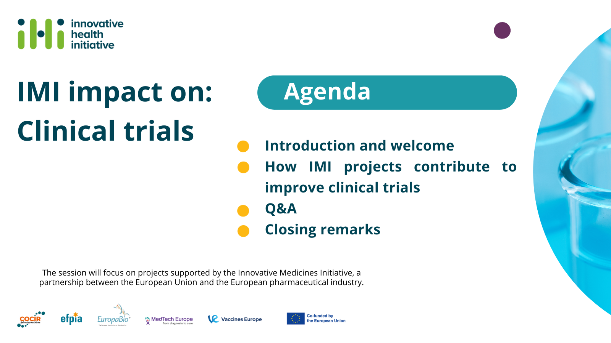
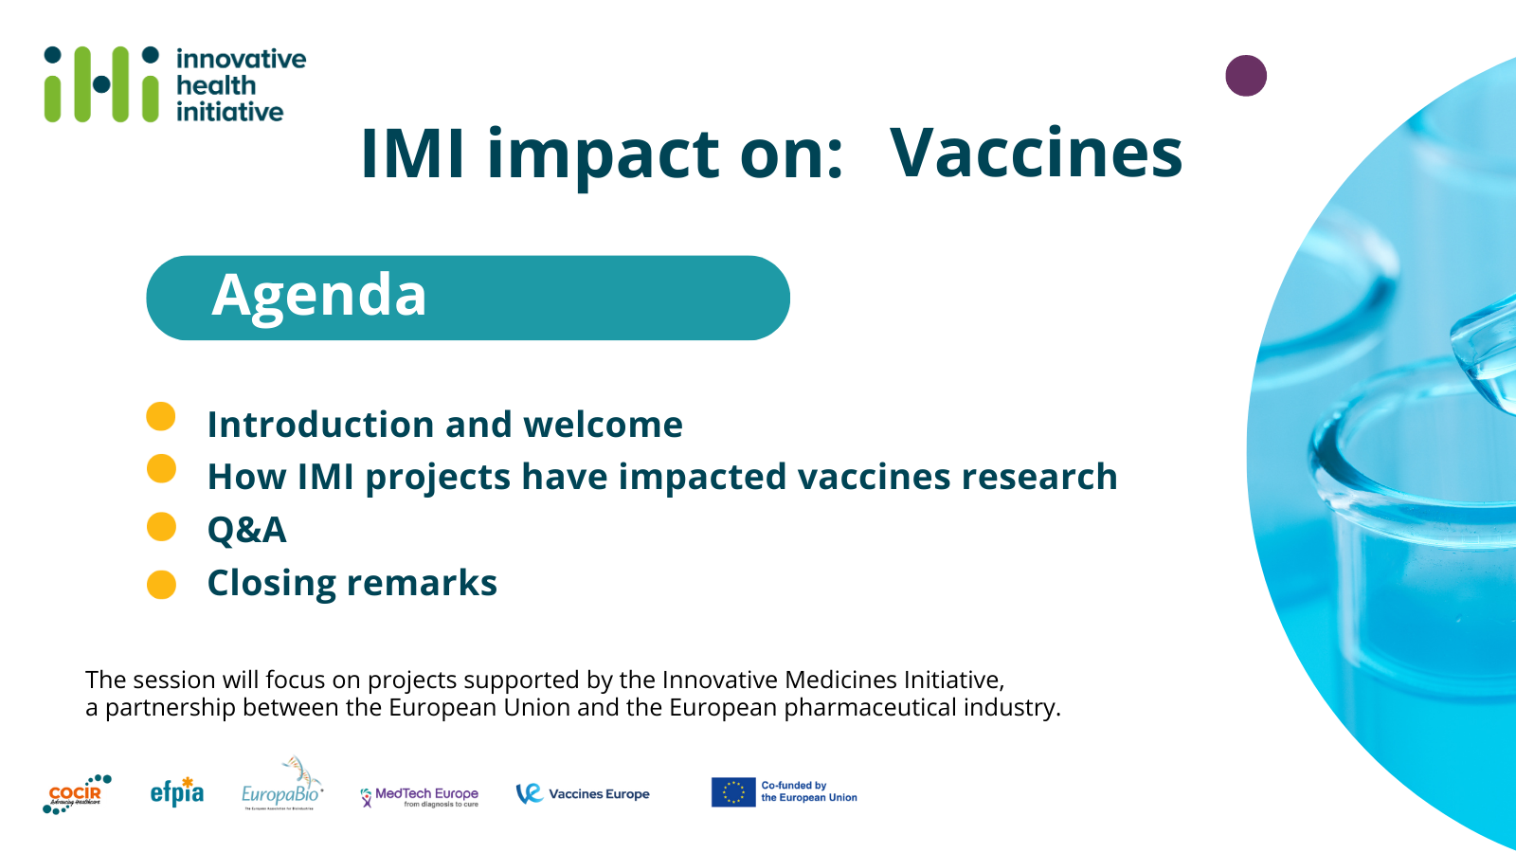
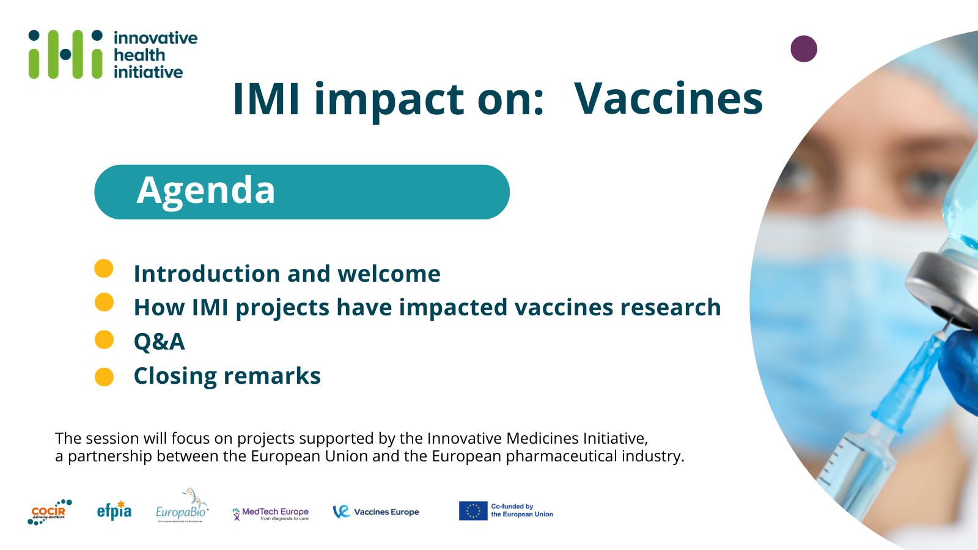

Slide 5
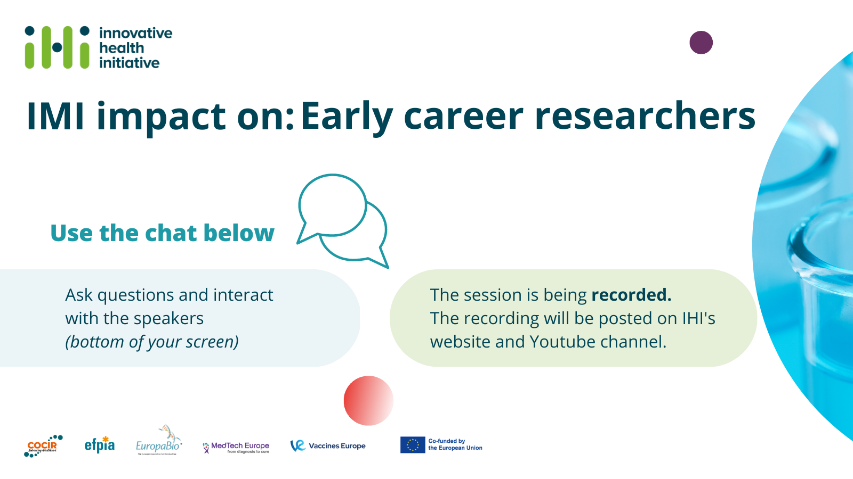
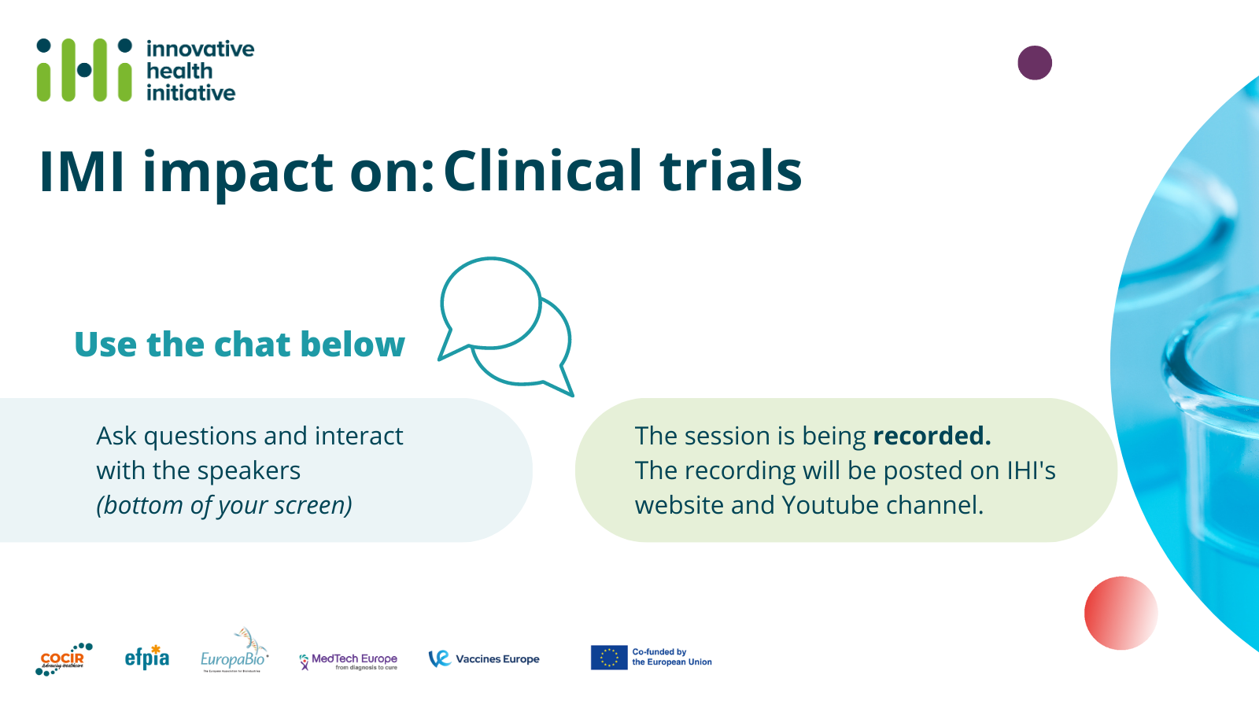
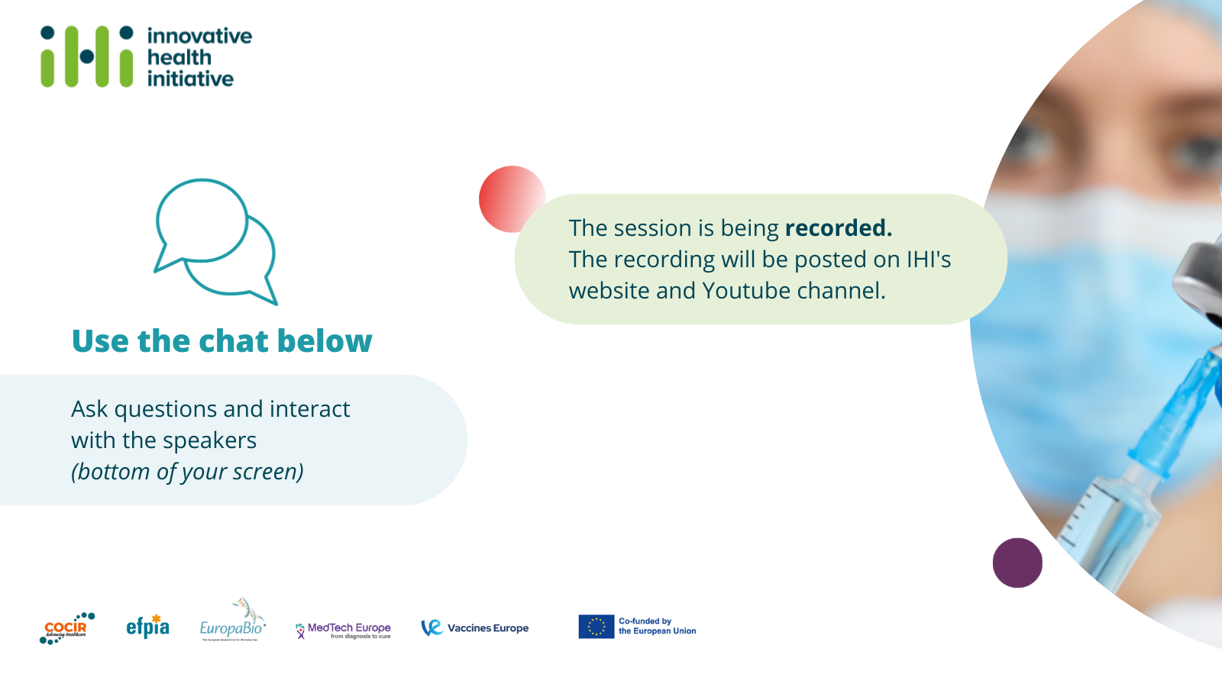

Slide 6
How do IMI projects facilitate innovations in vaccine development ?

Slide 7

1. In pre-clinical trials, how to limit animal testing in vaccine development?

Slide 8



Reducing the use of test animals through collaboration and innovation
Prof. Ole F. Olesen, European Vaccine Initiative
The VAC2VAC project has received funding from the Innovative Medicines Initiative 2 Joint Undertaking under grant agreement N° 115924. This Joint Undertaking receives support from the European Union's Horizon 2020 research and innovation programme and EFPIA (www.imi.europa.eu). This communication reflects the author´s view and neither IMI nor the European Union, EFPIA, or any Associated Partners are responsible for any use that may be made of the information contained herein.

Slide 9
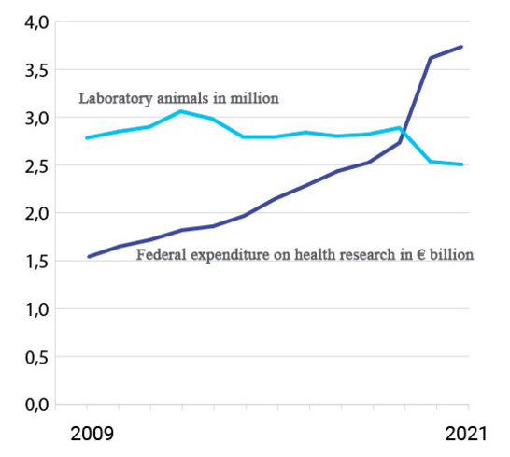
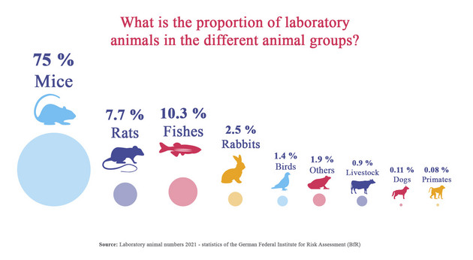
Extensive use of Experimental Animals
More than 115 million experimental animals are used each year globally (Humane Society International)
Around 750,000 animals used in EU for Quality Control
(including batch safety & potency testing) (ALURES)
Experimental animals used in Germany

Slide 10

VAC2VAC’s primary goal
Develop and validate tests and approaches using non-animal methods that will support and allow acceptance of the "Consistency Approach" for quality control of established vaccines by the regulatory agencies - thereby significantly reduce the future use of animals for batch testing in routine vaccine production.

Slide 11
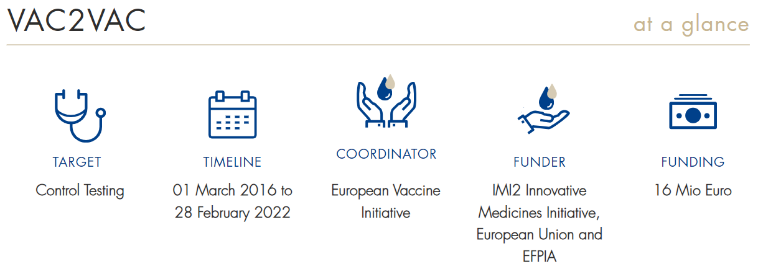
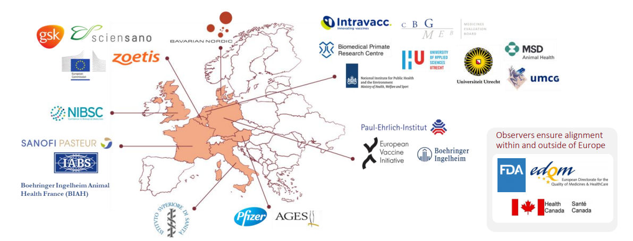
VAC2VAC Consortium: 23 partners in 8 countries
EFPIA/Industry: 9
Reference Labs/Public Research Orgs: 7
Academia: 3
NGO’s and private non-profit organisations: 4

Slide 12
VAC2VAC: project architecture
WP1
Physicochemical methods for consistency testing
WP2
Immunochemical methods for consistency testing
WP3
Cell-based assays for consistency testing
WP4
Bioinformatics Genome/Proteome expression analysis technologies
WP5
Validation criteria, transferability, inter-laboratory validation
WP6
Promotion of Consistency testing to Regulatory acceptance
WP7
Project management
Communication and dissemination activities

Slide 13
Consistency approach
Regulators require that vaccine batches are tested for potency and safety before released onto the market (stated in monographs of relevant pharmacopoeias).
  Safety tests: to detect contaminants or active toxins
  Potency test: to induce the same amount of protective immune response as was found in the initial batches of vaccine used in the clinical trials
The Consistency Approach assesses the quality of vaccine batches by demonstrating similarity to a reference vaccine with proven clinical safety and efficacy using physio-chemical and immunological characterisation of parameters such as quantity, identity, antigenicity, purity, size and functionality.

Slide 14
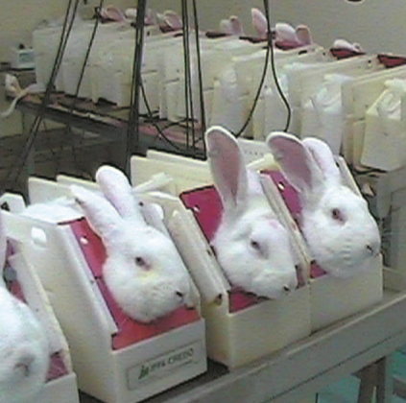
Rabbit Pyrogen Test (RPT)
Pyrogens = fever inducing substances
RPT developed in the 1920’s
Measures the rise in body temperature in healthy rabbits
Groups of 3 rabbits used for initial testing (temperature rise <0.6 C)
Additional group tested in case of failure in initial group
In 2015 (at the start of VAC2VAC), almost 50,000 rabbits were used for pyrogen testing in 14 Member States
The monocyte-activation test (MAT) was introduced in the European Pharmacopoeia (Ph. Eur.) in 2009 as official in vitro alternative to RPT.

Slide 15
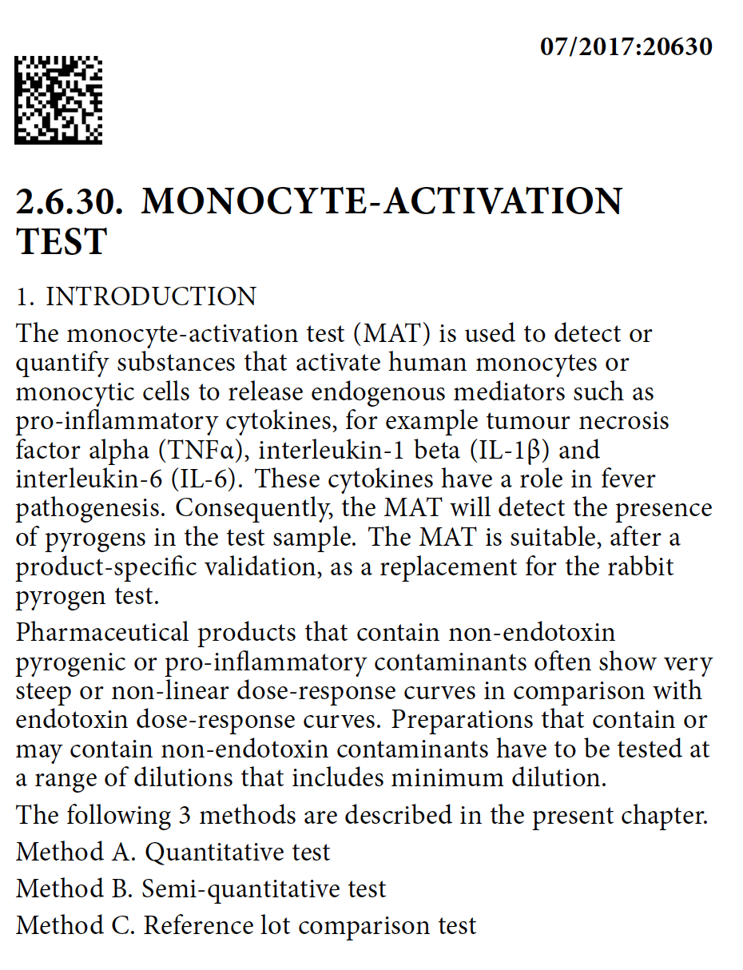
Replacing RPT with MAT for human Tick-Borne Encephalitis Virus (TBEV) vaccine
Objective:
To replace the existing RPT for human TBEV vaccine by the monocyte activation test (MAT)
Monocyte Activation Test (MAT):
MAT can be used to quantify substances that activate human monocytes or monocytic cells (e.g., using human peripheral blood mononuclear cells - h-PBMC) to release endogenous mediators such as pro-inflammatory cytokines that play a role in fever pathogenesis

Slide 16
Setting of MAT conditions for the Tick-borne encephalitis virus (TBEV) vaccine (III)
ACTIVE SUBSTANCE: Tick-Borne Encephalitis Virus (TBEV) Vaccine, inactivated by formaldehyde - ENCEPUR®.
EXCIPIENTS: Aluminum hydroxide, TRIS buffer, sucrose. Traces of tetracycline, gentamicine, neomycine and formaldehyde.
Cell source: human peripheral blood mononuclear cells (PBMCs);
Read-out: IL-6 release;
V1, V2, V3: Defined vaccine serial dilution;
E1, E2, E3, E4, E5: RSE chosen serial dilutions showing a linear correlation.
LOD = 0.04 EU/ml; MVD = 1:1000; Sensitivity = 0.1 EU/ml
E5
https://www.altex.org/index.php/altex/article/view/1734​

Slide 17
MAT validation on 3 TBEV vaccine lots
Validation was done by testing 3 lots on 4 different donors (One Analyst).
Further, a precision study evaluated the impact of donors, analysts and analytical session on intermediate precision and repeatability of the assay (Etna et al. Altex 2020).
OD: Optical Density
RSE: Reference Standard Endotoxin
eEU/ml: Equivalent of Endotoxin Unit
CLC: Contaminant Limit Concentration

Slide 18
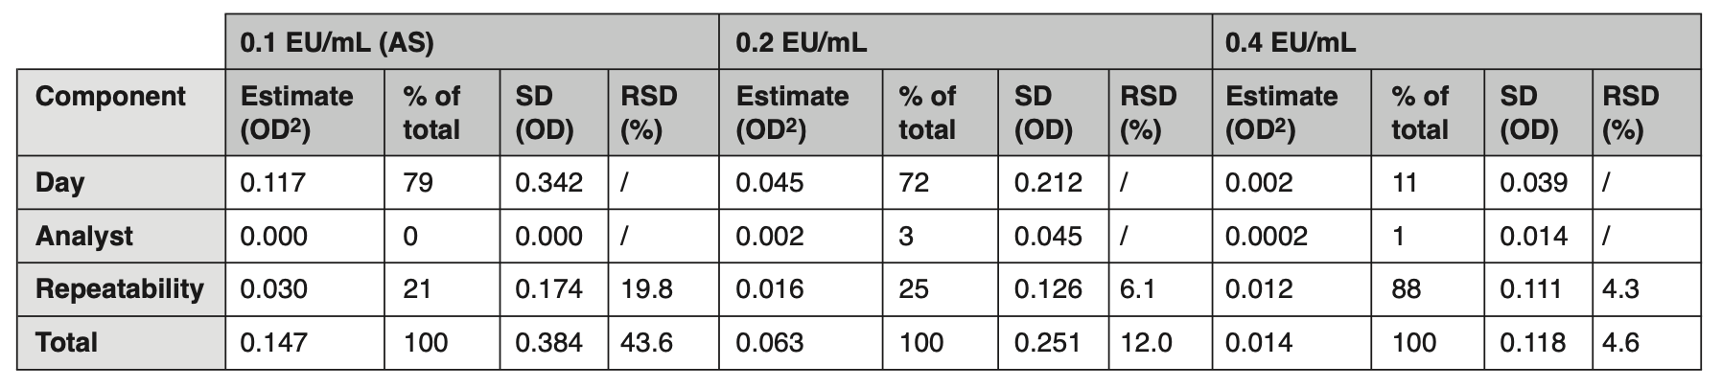
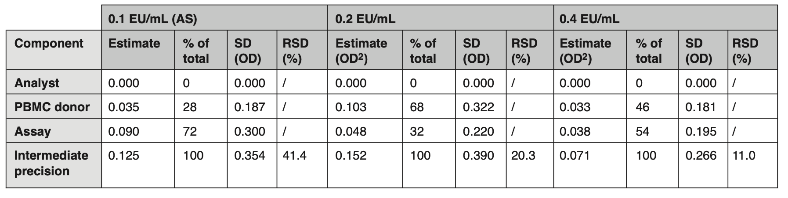
Precision study according to ICH Q2(R1)
Repeatability of the method:
evaluated on the OD values obtained from 5 different sessions, each performed by 2 Analysts (total of 10) using PBMC from the same donor on 3 RSE doses. [RSD ≤ 20 %]
Intermediate precision of the method: calculated on the OD values obtained from a total of 20 different sessions performed by 2 Analysts using PBMC from 8 different donors on 3 RSE doses. [RSD ≤ 35 %]
Etna MP et al., ALTEX 37(4), 532-544. doi:10.14573/altex.2002252
OD: Optical Density
RSE: Reference Standard Endotoxin
RSD: Relative standard deviation
Notes:
REPEATABILITY&INTERMEDIATE PRECISION: conducted on 3 RSE doses namely 0.1, 0.2 and 0.4 EU/mL, corresponding to the assay sensitivity (AS), 2 x AS and 4 x AS, respectively.

Slide 19
What happened next?
MAT validated according to ICH-Q2B on 3 ENCEPUR batches by academic partners (led by ISS, Italy);
Method transferred to industry partner (GSK) for internal validation;
GSK applied for approval to the German Regulator (Paul-Ehrlich Institute, PEI) at the end of 2019 (approval in May 2020). PEI was selected due to the original registration of the product.
March 2021: Request submitted (by the Italian delegation) to replace the rabbit pyrogen test by MAT in European Pharmacopoeia monograph 1375 (“tick-borne encephalitis vaccine”).
June 2021: European Pharmacopoeia Commission decided to remove the rabbit pyrogen test from its texts by 2026 (affecting 60 Ph. Eur. texts)
Between 2015 and 2020, Rabbit Pyrogen Testing decreased by 49% in Europe
RPT has been replaced with MAT in routine testing by GSK, later Bavarian Nordic
Estimated by GSK to spare more than 100 rabbits annually at the time of application

Slide 20
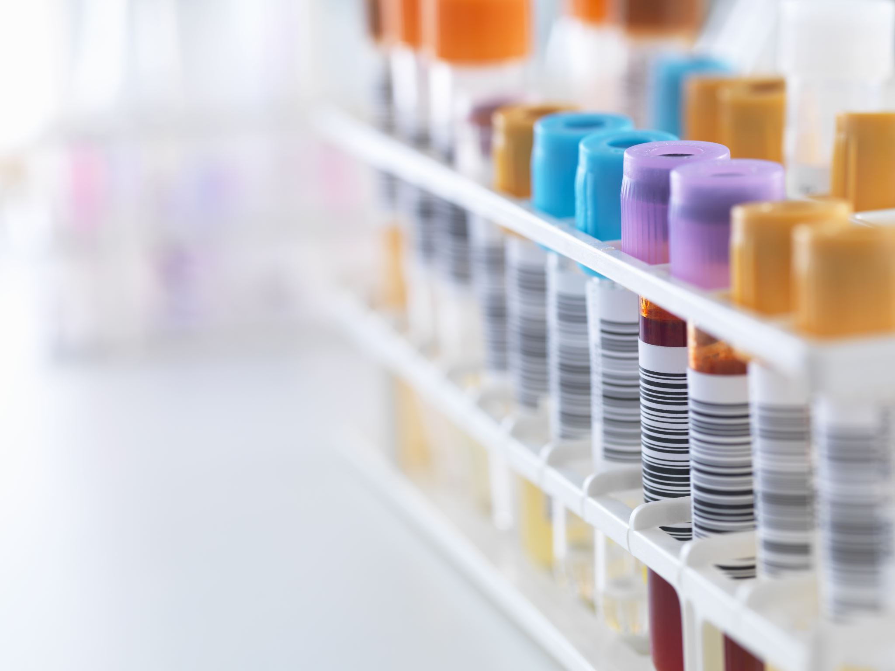
Other successes of VAC2VAC
LC-MS/MS assay for measuring Tetanus Neurotoxin (TeNT) in the production of tetanus vaccine
  Development and validation of a targeted LC-MS/MS quantitation (i.e, non-antibody based) method to monitor cell culture expression of tetanus neurotoxin during production of tetanus vaccine (tetanus toxoid) (Francotte et al., 2022)
ELISA assays
Seven ELISA assays have been qualified and transferred to industry for product-specific optimisation and validation (including Diphtheria, Tetanus and TBEV)
Open Access to critical reagents for further study
  12 purified monoclonal antibodies (mAbs) that were obtained during VAC2VAC are available from nibsc.org. The antibodies are intended for further development and validation of immunoassays for diphtheria, tetanus and acellular pertussis (DTaP) vaccines
Stakeholder Engagement
  Implementation of the Consistency Approach: a roadmap for achieving meaningful change in regulatory policy through replacement of in vivo methods with in vitro methods.
  VAC2VAC Regulatory Stakeholder webinar (133 participants from 22 countries). Discussions on implementation of VAC2VAC assays & methods
22 peer-reviewed open access publications (so far)

Slide 21
Conclusions
Results may not be spectacular nor radical (we will not get the Nobel Prize!)
Tangible result with immediate application
Feasibility of replacement of in vivo methods with in vitro methods: Contribution to a 3R research agenda
VAC2VAC has already saved the lives of 1000’s of experimental animals -.
The assays and methods would NOT have been developed without the close collaboration between industry, academic partners and regulators
VAC2VAC’s results and success are a direct result of public-private collaboration, catalyzed by IMI/IHI’s funding and vision.

Slide 22
Acknowledgements
The VAC2VAC project has received funding from the Innovative Medicines Initiative 2 Joint Undertaking under grant agreement N° 115924. This Joint Undertaking receives support from the European Union's Horizon 2020 research and innovation programme and EFPIA (www.imi.europa.eu). This communication reflects the author´s view and neither IMI nor the European Union, EFPIA, or any Associated Partners are responsible for any use that may be made of the information contained herein.
Project Partners:
Bavarian Nordic (Denmark); Biomedical Primate Research Centre (BPRC) (Netherlands); Boehringer Ingelheim (BI) (Germany); College ter Beoordeling van Geneesmiddelen (CBG/ MEB) (Netherlands); Joint Research Centre (JRC) - European Commission (Belgium); European Vaccine Initiative (EVI) (Germany); GSK Biologicals (GSKBio) (Belgium); Institute for Translational Vaccinology (Intravacc BV) (Netherlands); International Alliance for Biological Standardization for Europe (IABS-EU) (France); Istituto Superiore
di Sanità (ISS) (Italy); Merck Sharp & Dohme (MSD) (Netherlands); Merial, National Institute for Biological Standards and Control (DH-NIBSC) (UK); National Institute for
Public Health and the Environment (RIVM) (Netherlands); Austrian Agency for Health and Food Safety: AGES (Austria); Paul-Ehrlich Institute (PEI) (Germany); Pfizer
(Austria); Sanofi Pasteur (France); Sciensano (Belgium); University Medical Center Groningen (UMCG) (Netherlands); University of Applied Sciences
Utrecht (HU) (Netherlands); University of Utrecht (Netherlands); Zoetis Belgium SA. (Belgium).

Slide 23

2. When next generation vaccines are needed?

Slide 24
PERISCOPE project
Accelerating the development of next-generation pertussis vaccines
Dimitri Diavatopoulos
Radboudumc – The Netherlands
IMI impact on vaccines | 10/11/2023

Slide 25
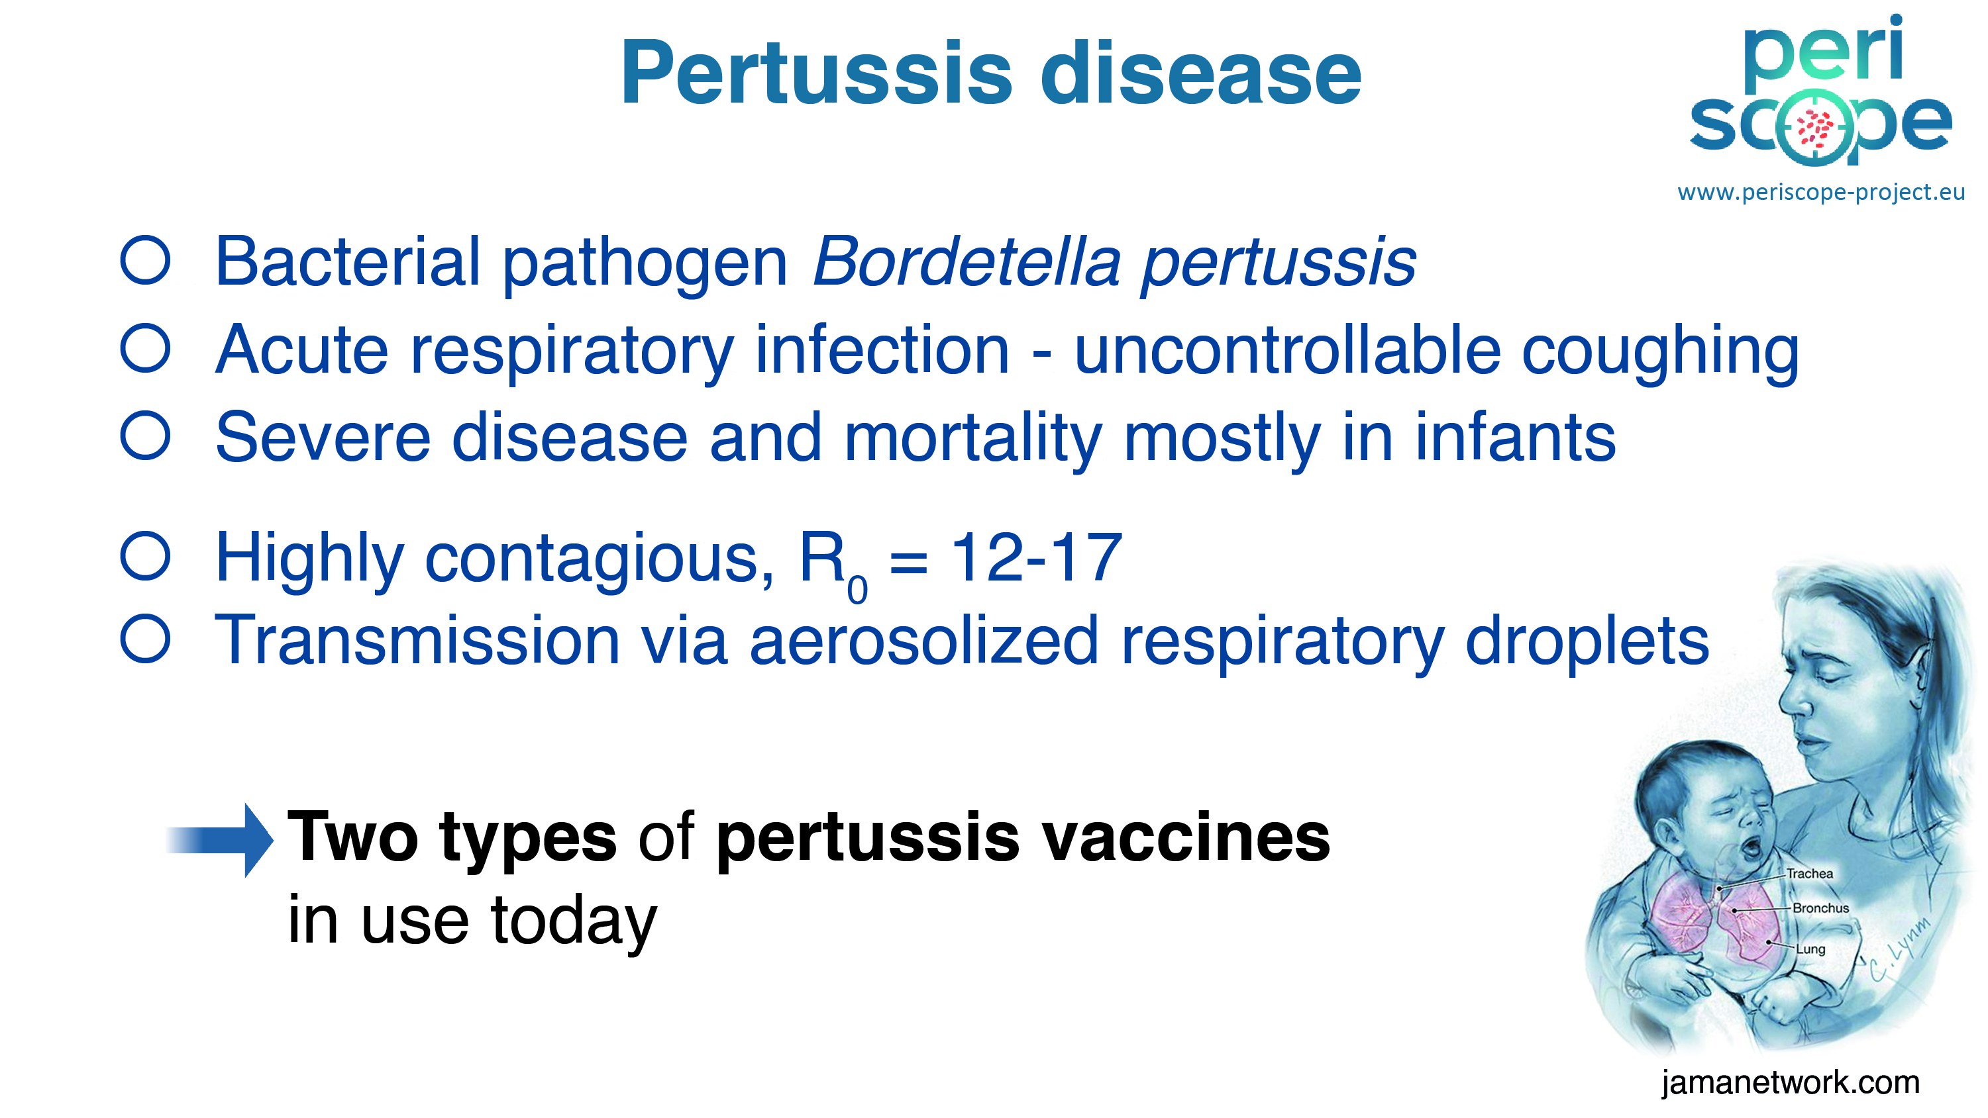

Slide 26
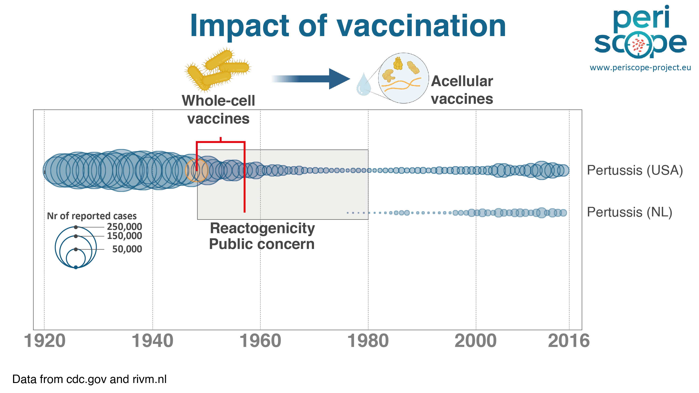

Slide 27
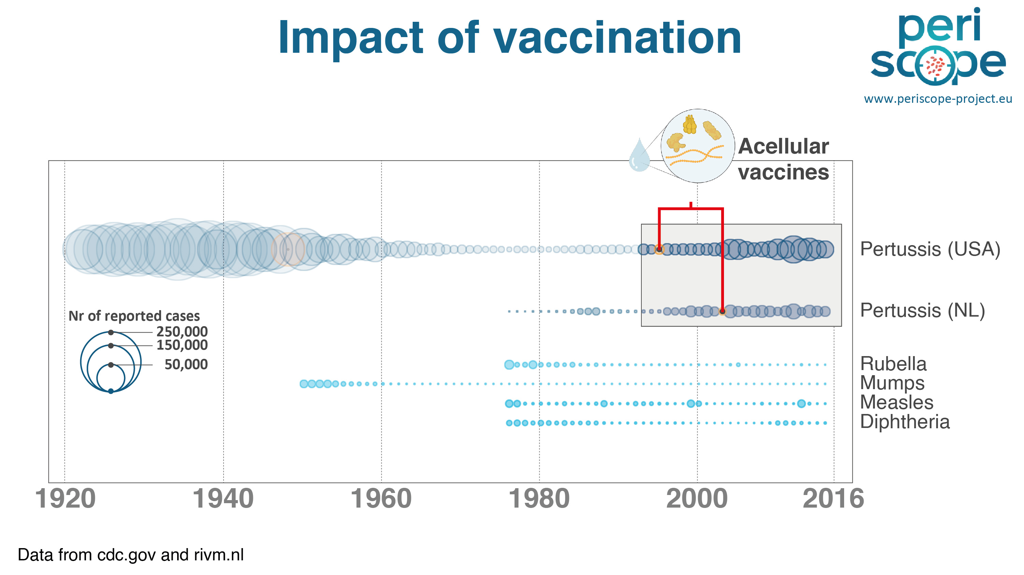

Slide 28
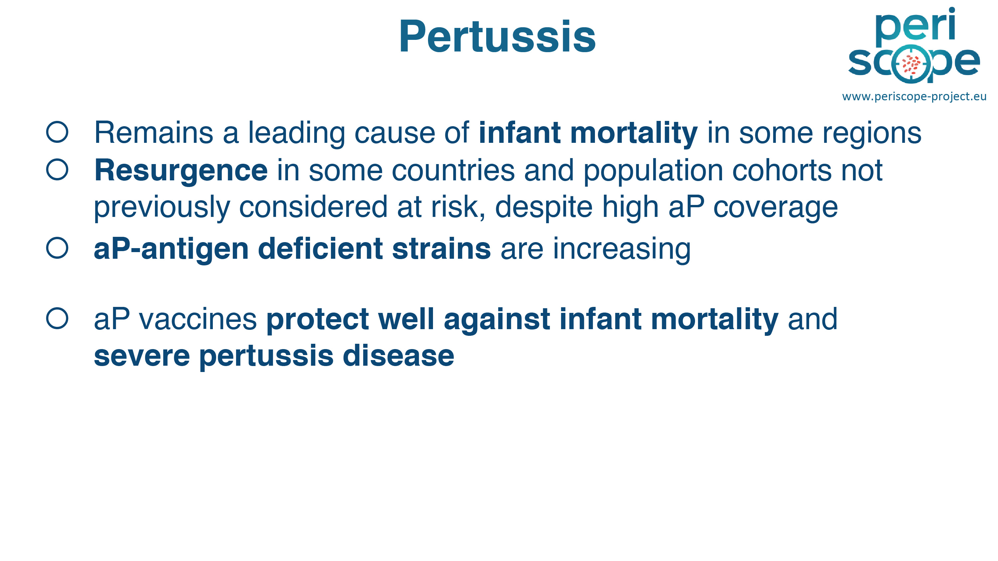

Slide 29
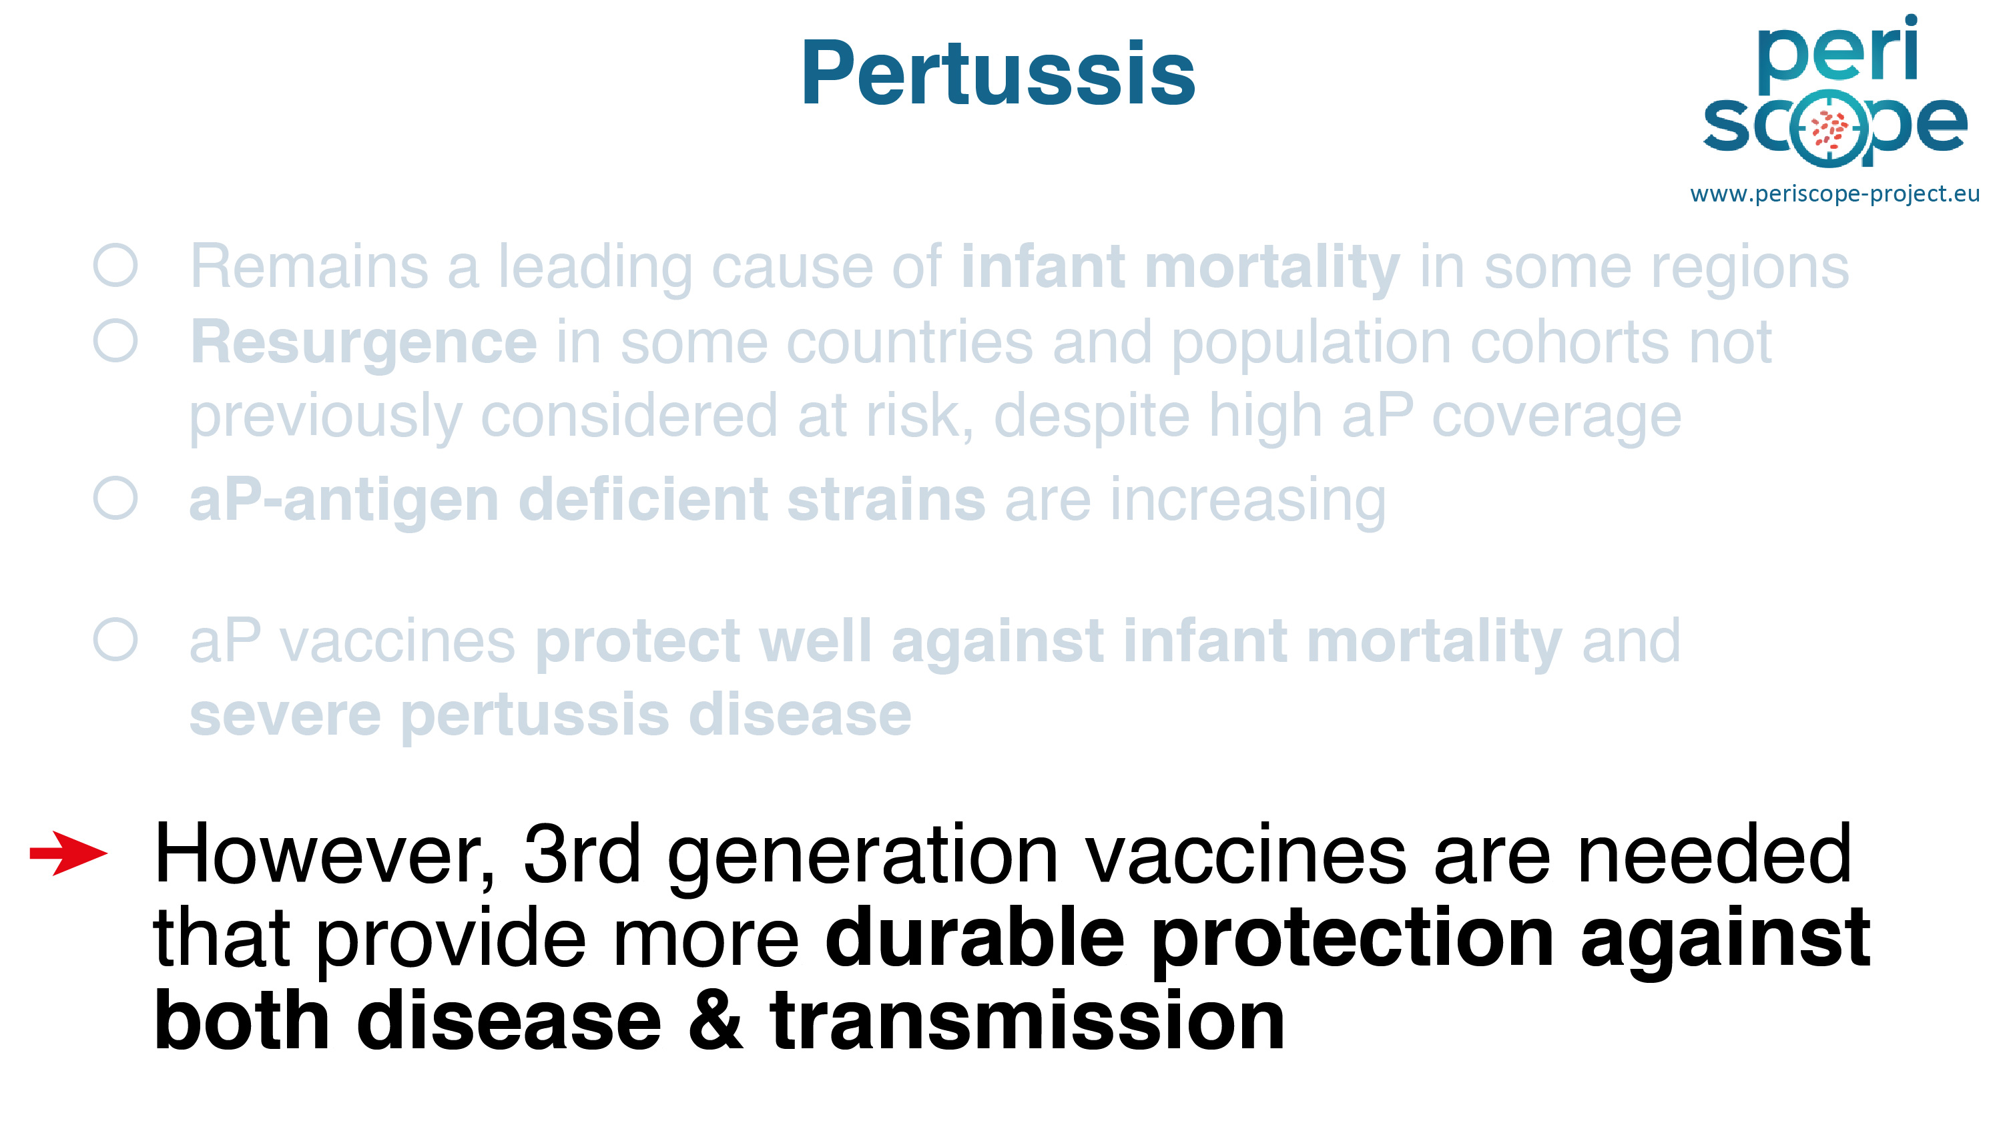

Slide 30
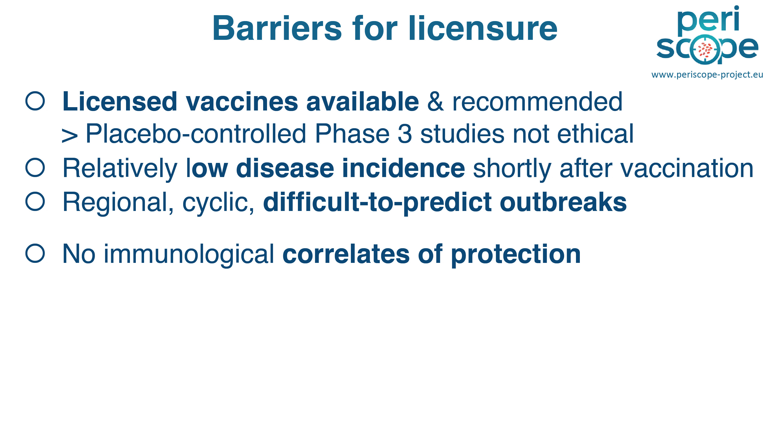

Slide 31
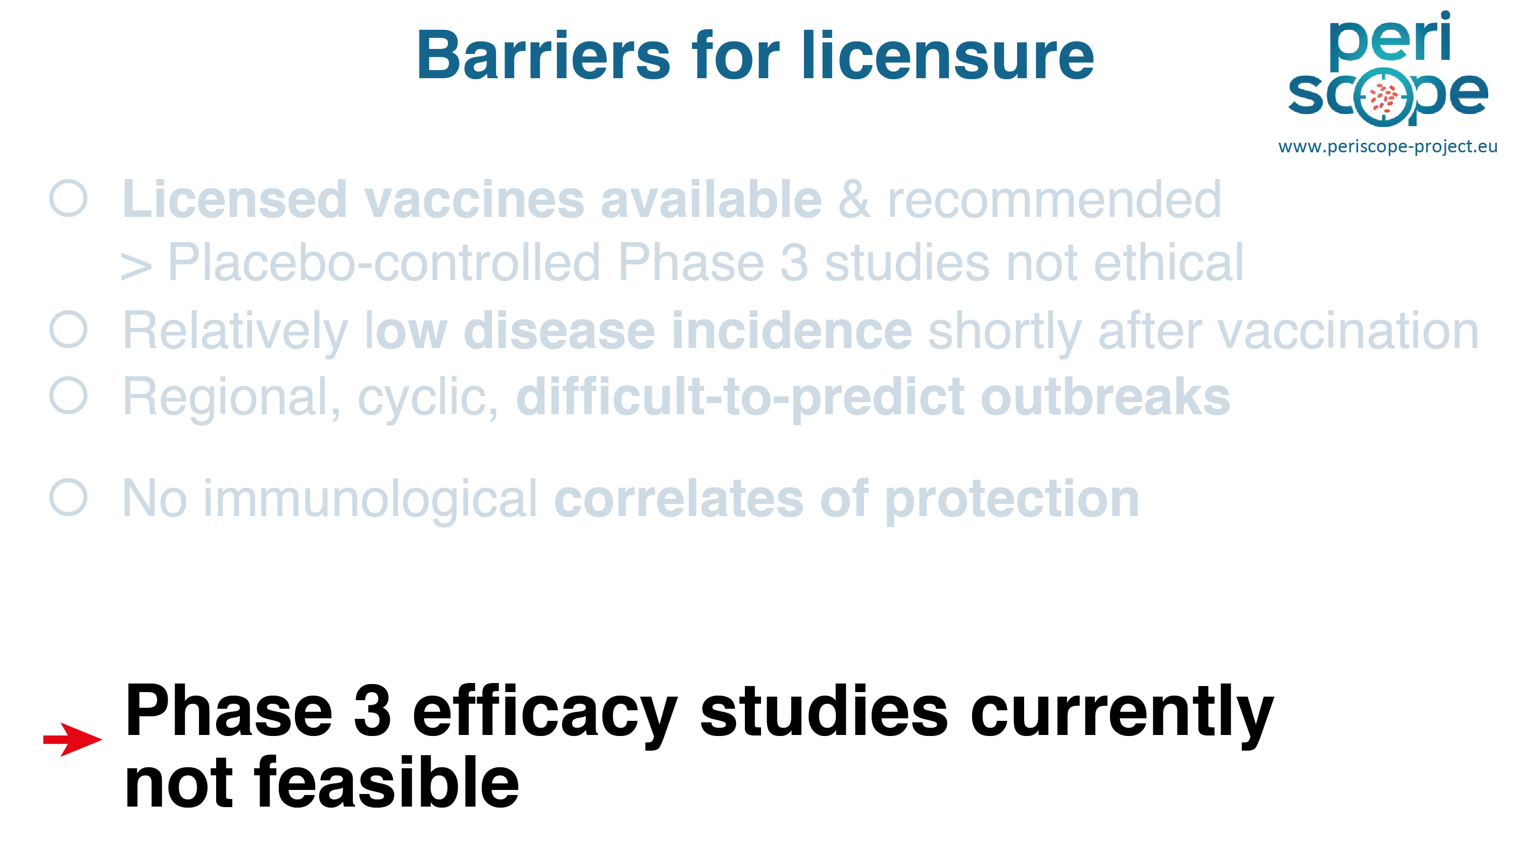

Slide 32
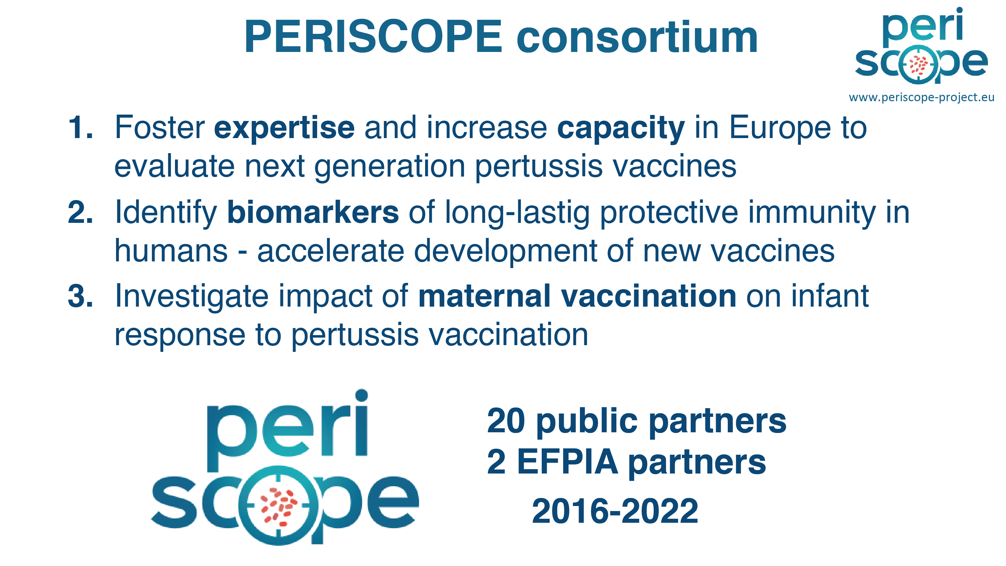

Slide 33
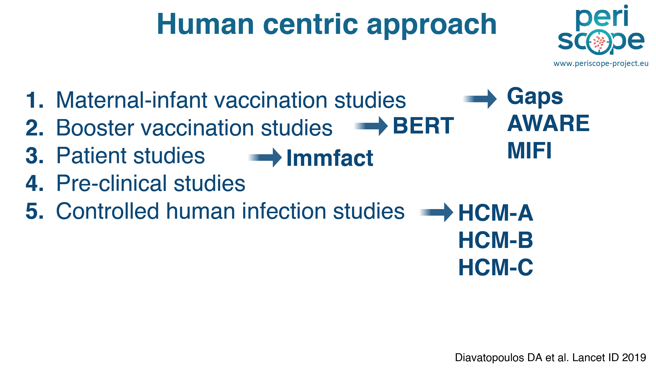

Slide 34
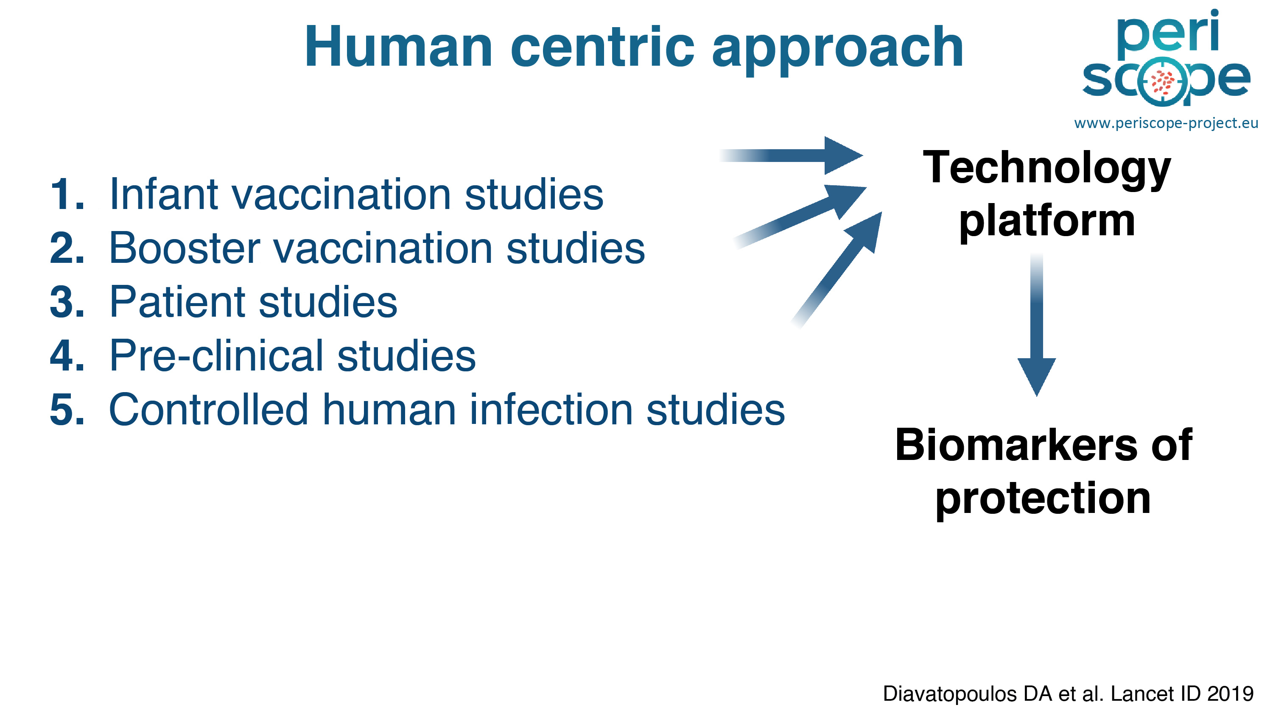

Slide 35
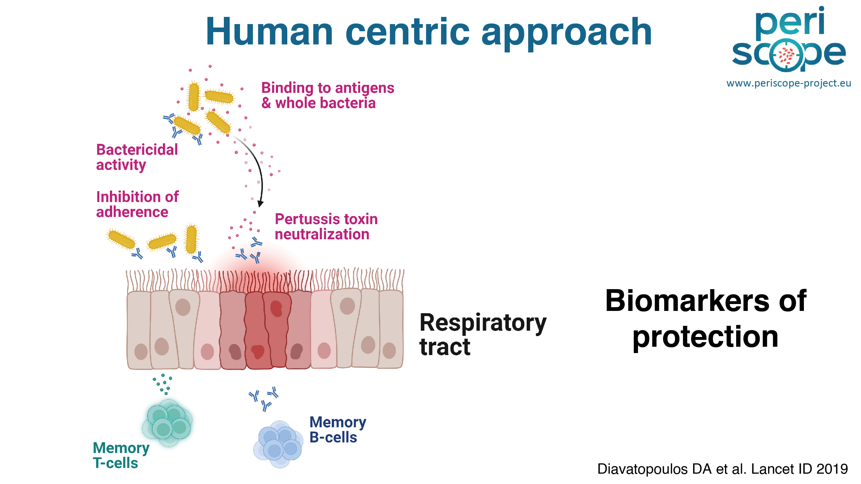

Slide 36
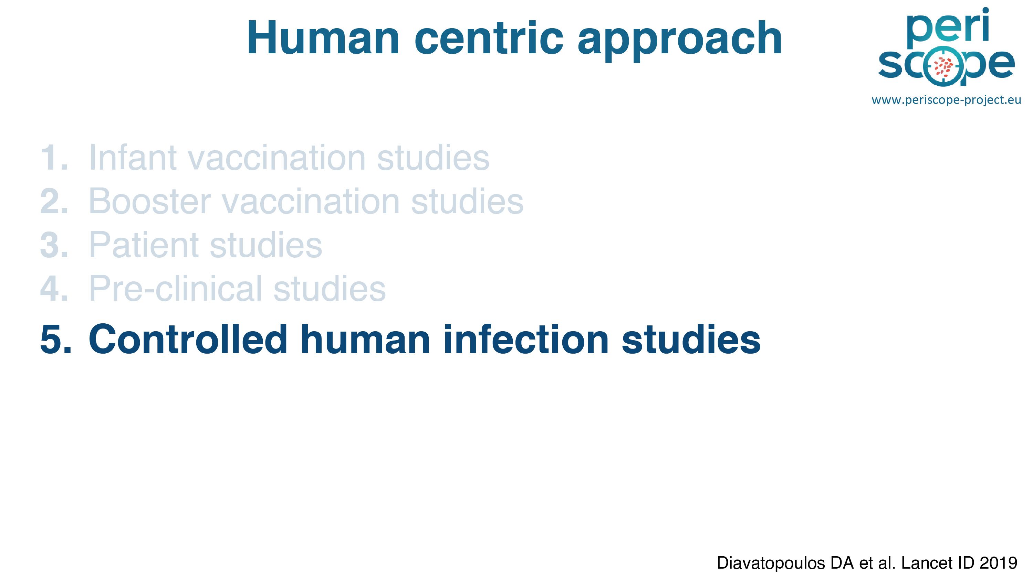

Slide 37
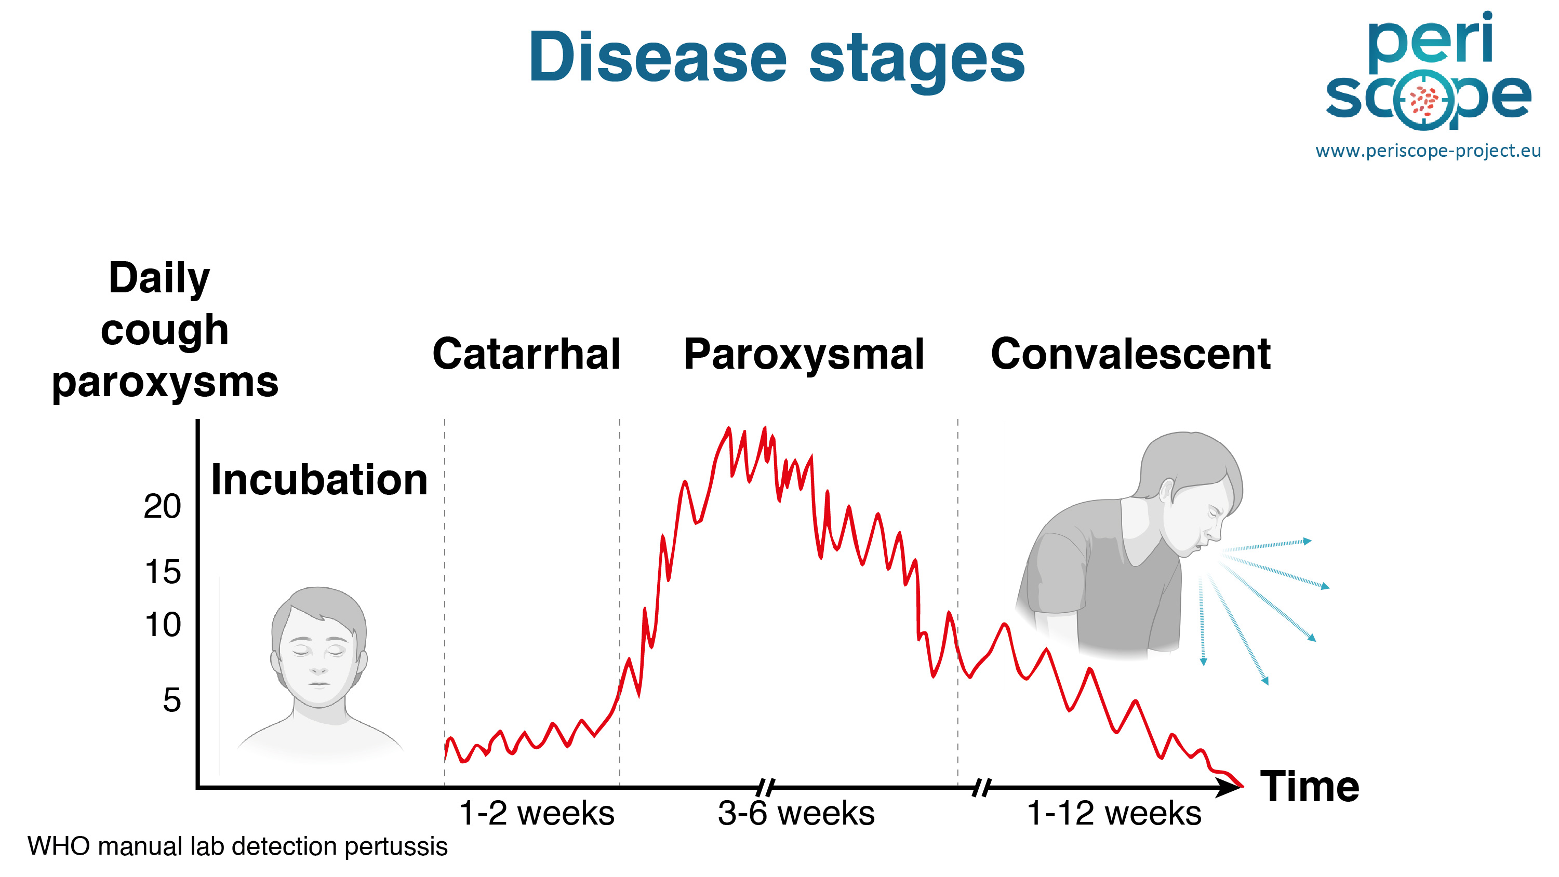

Slide 38
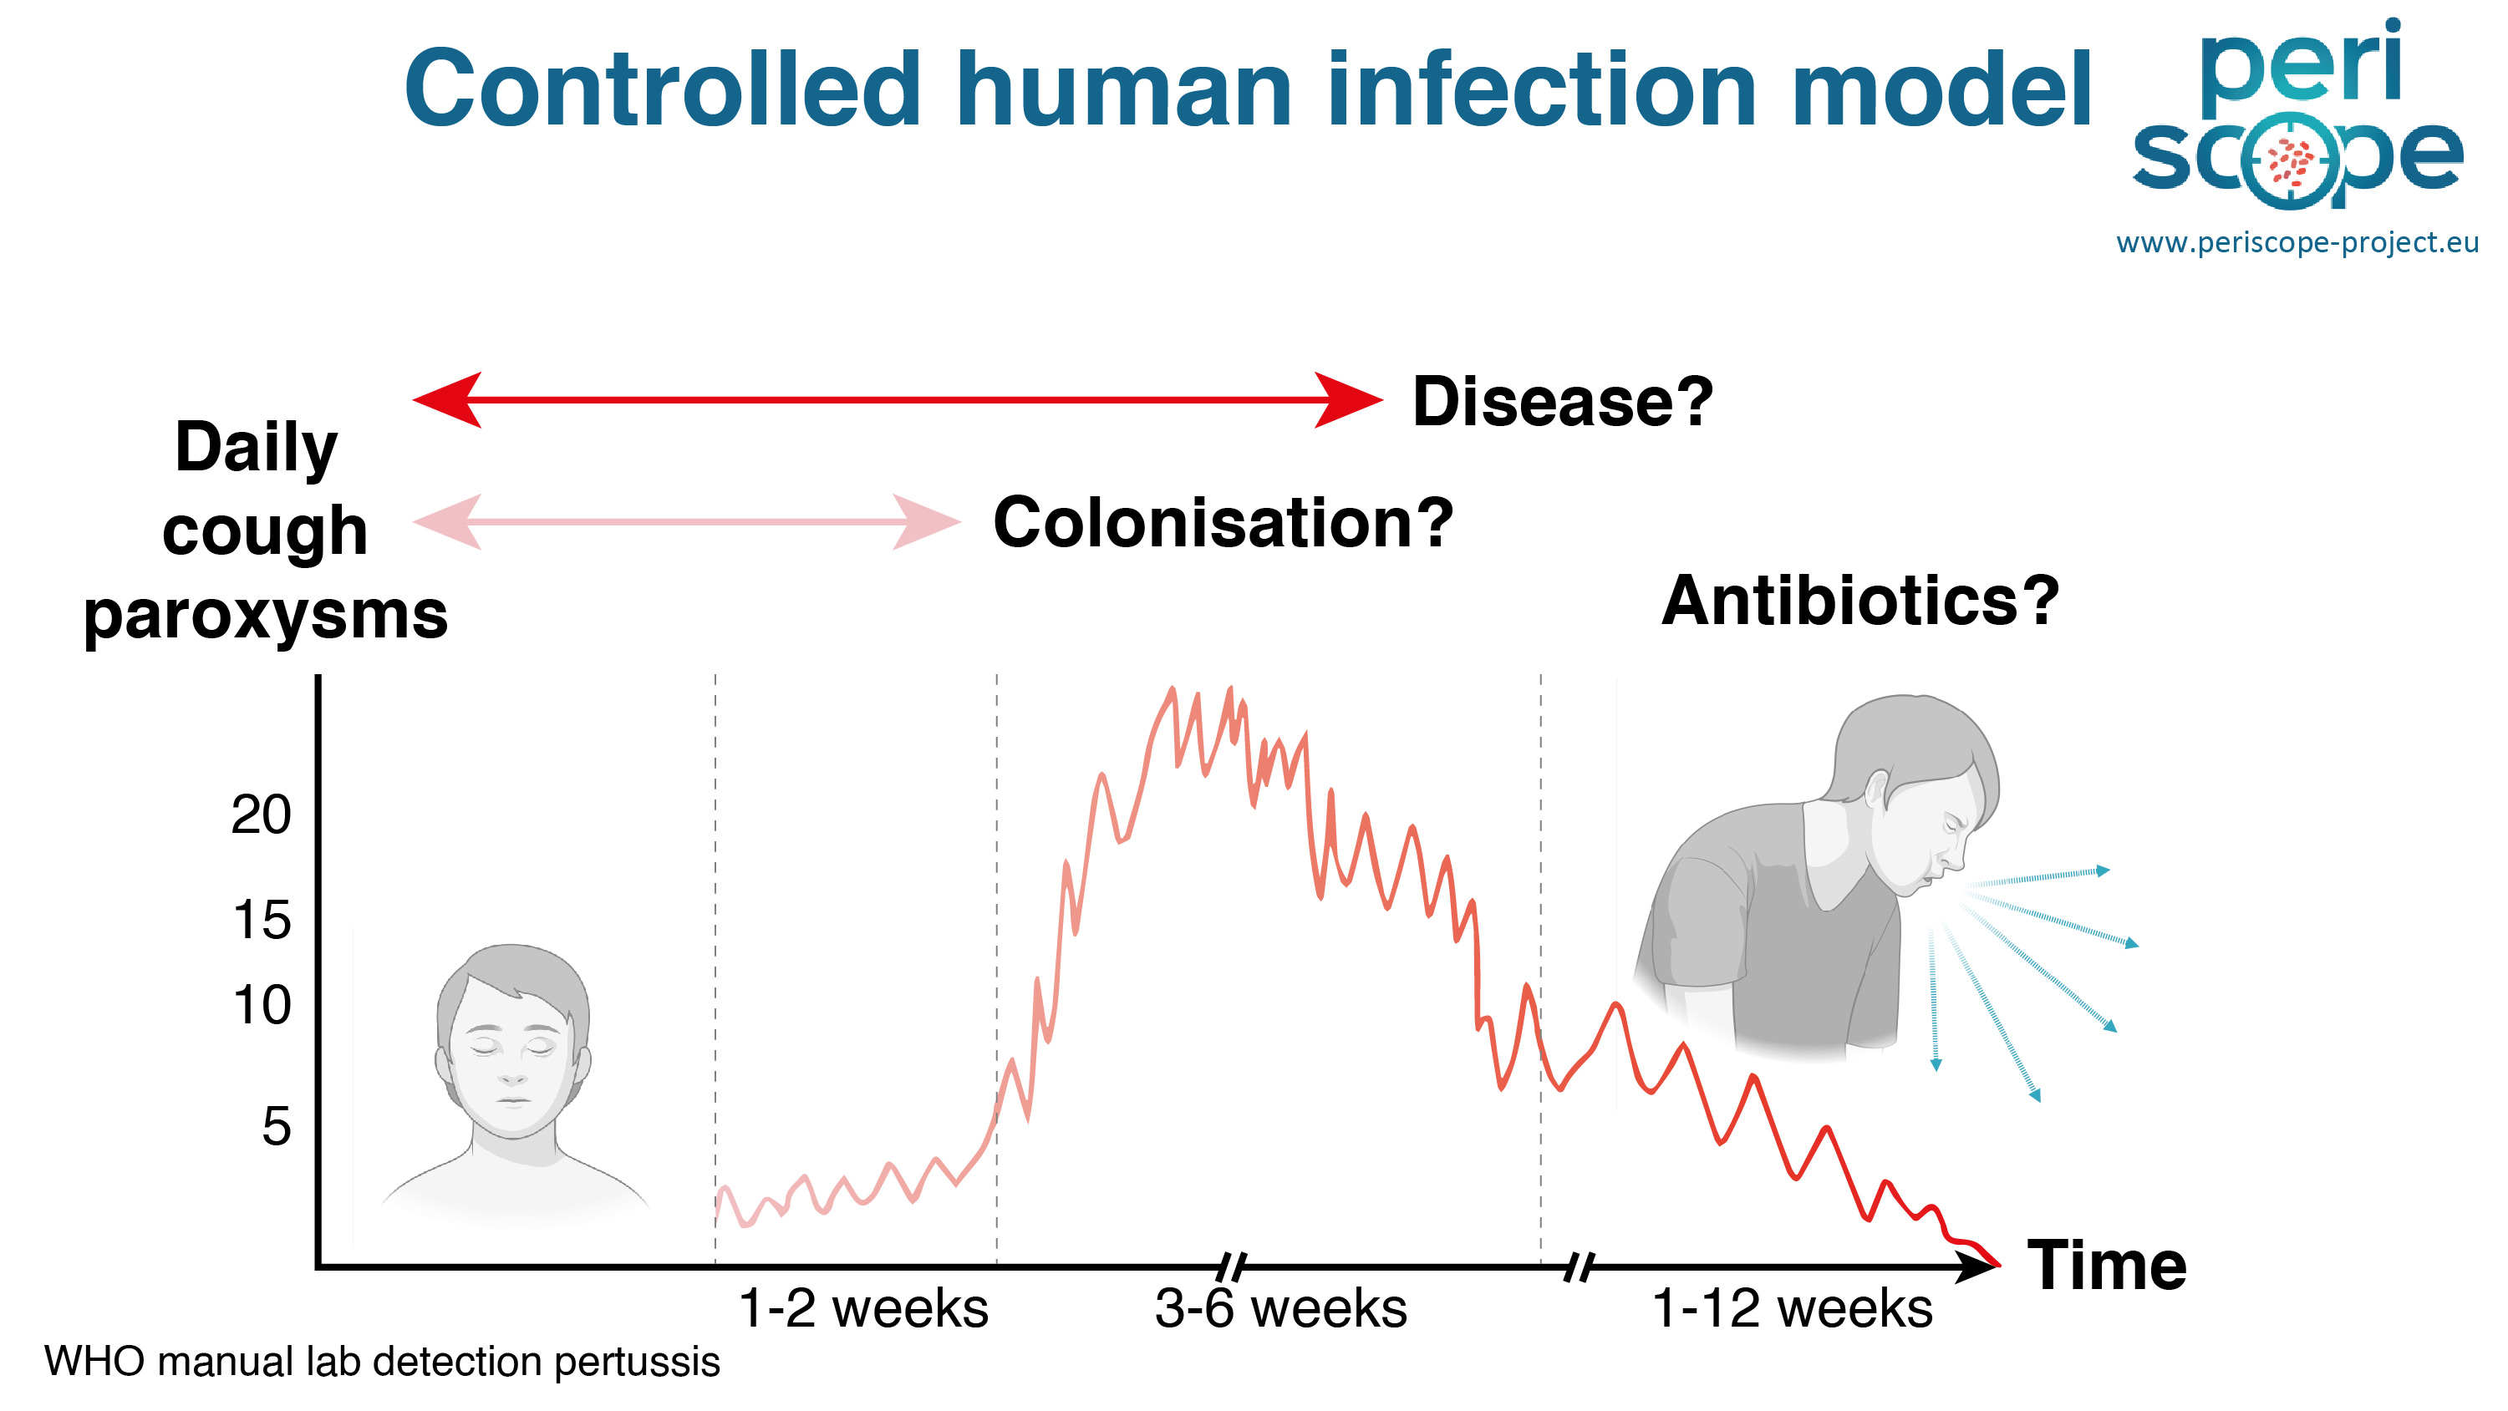

Slide 39
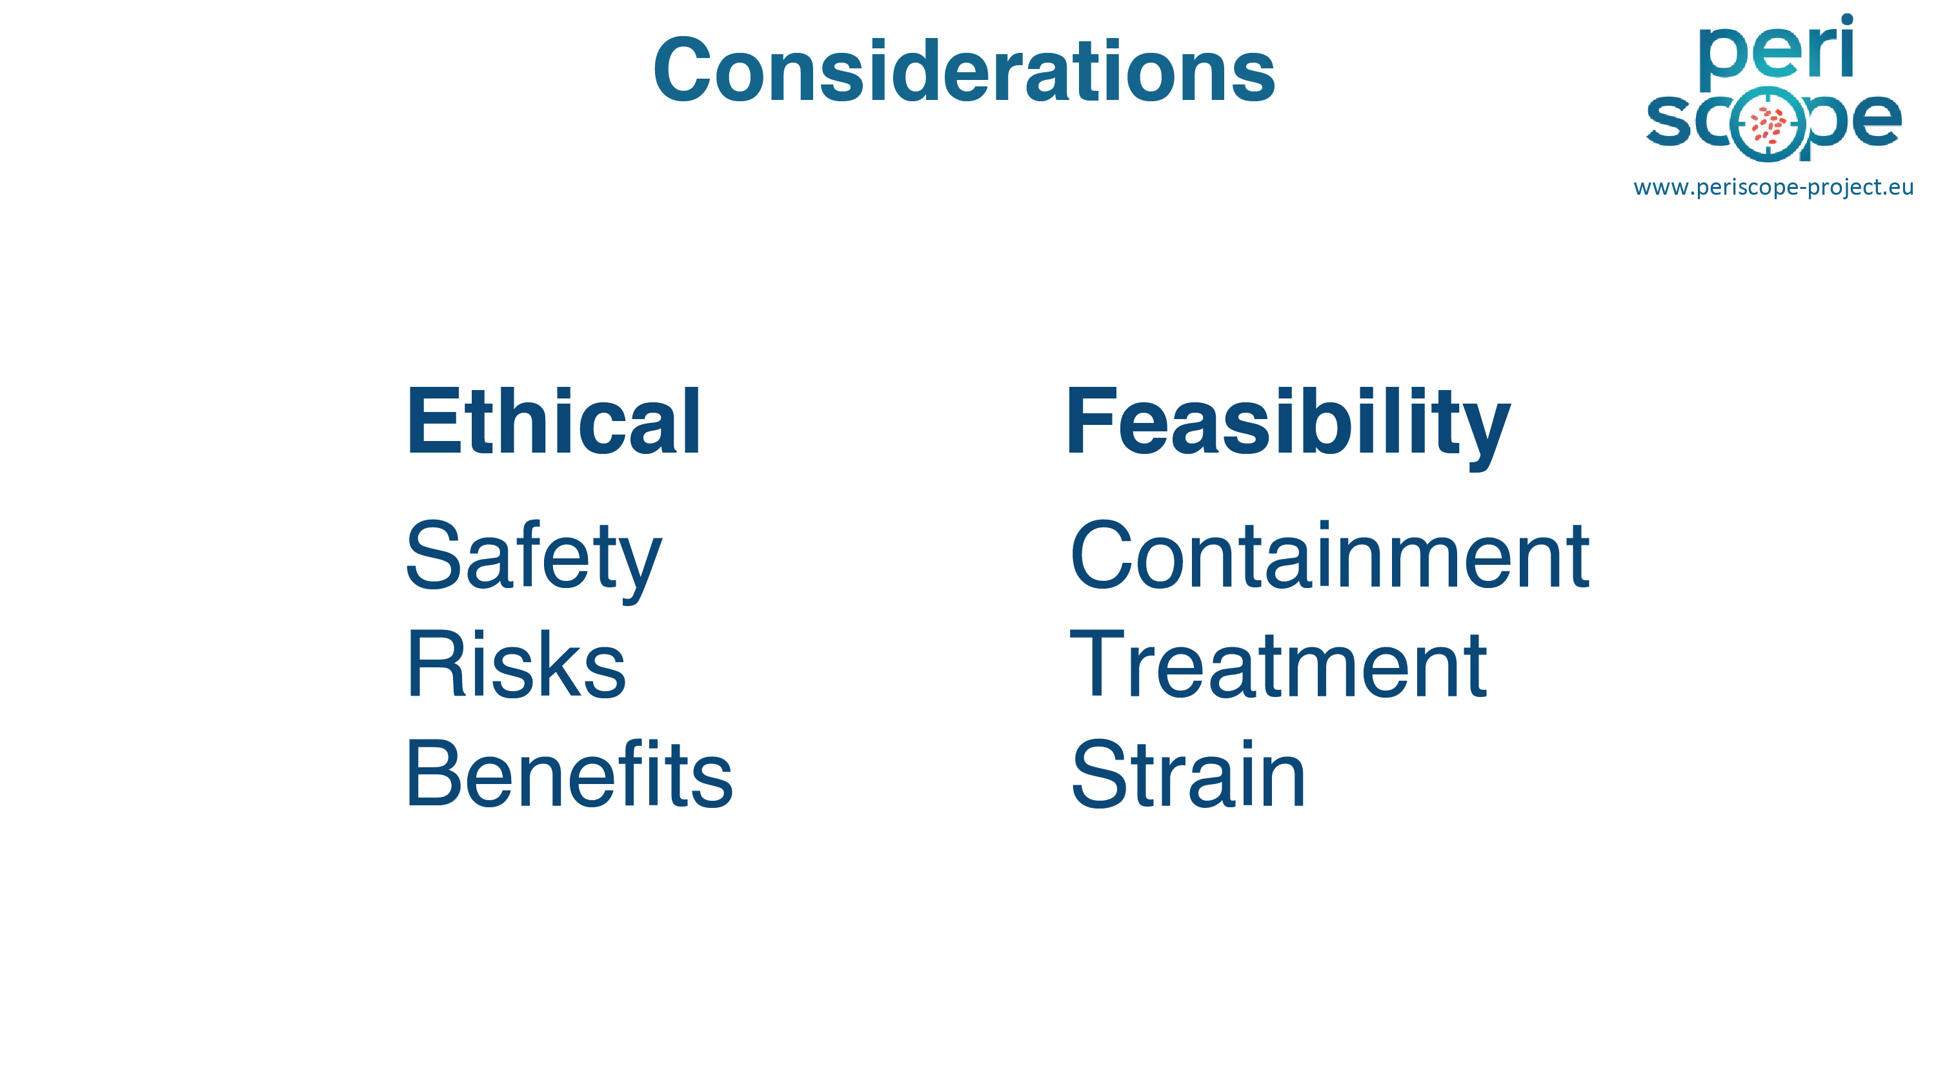

Slide 40
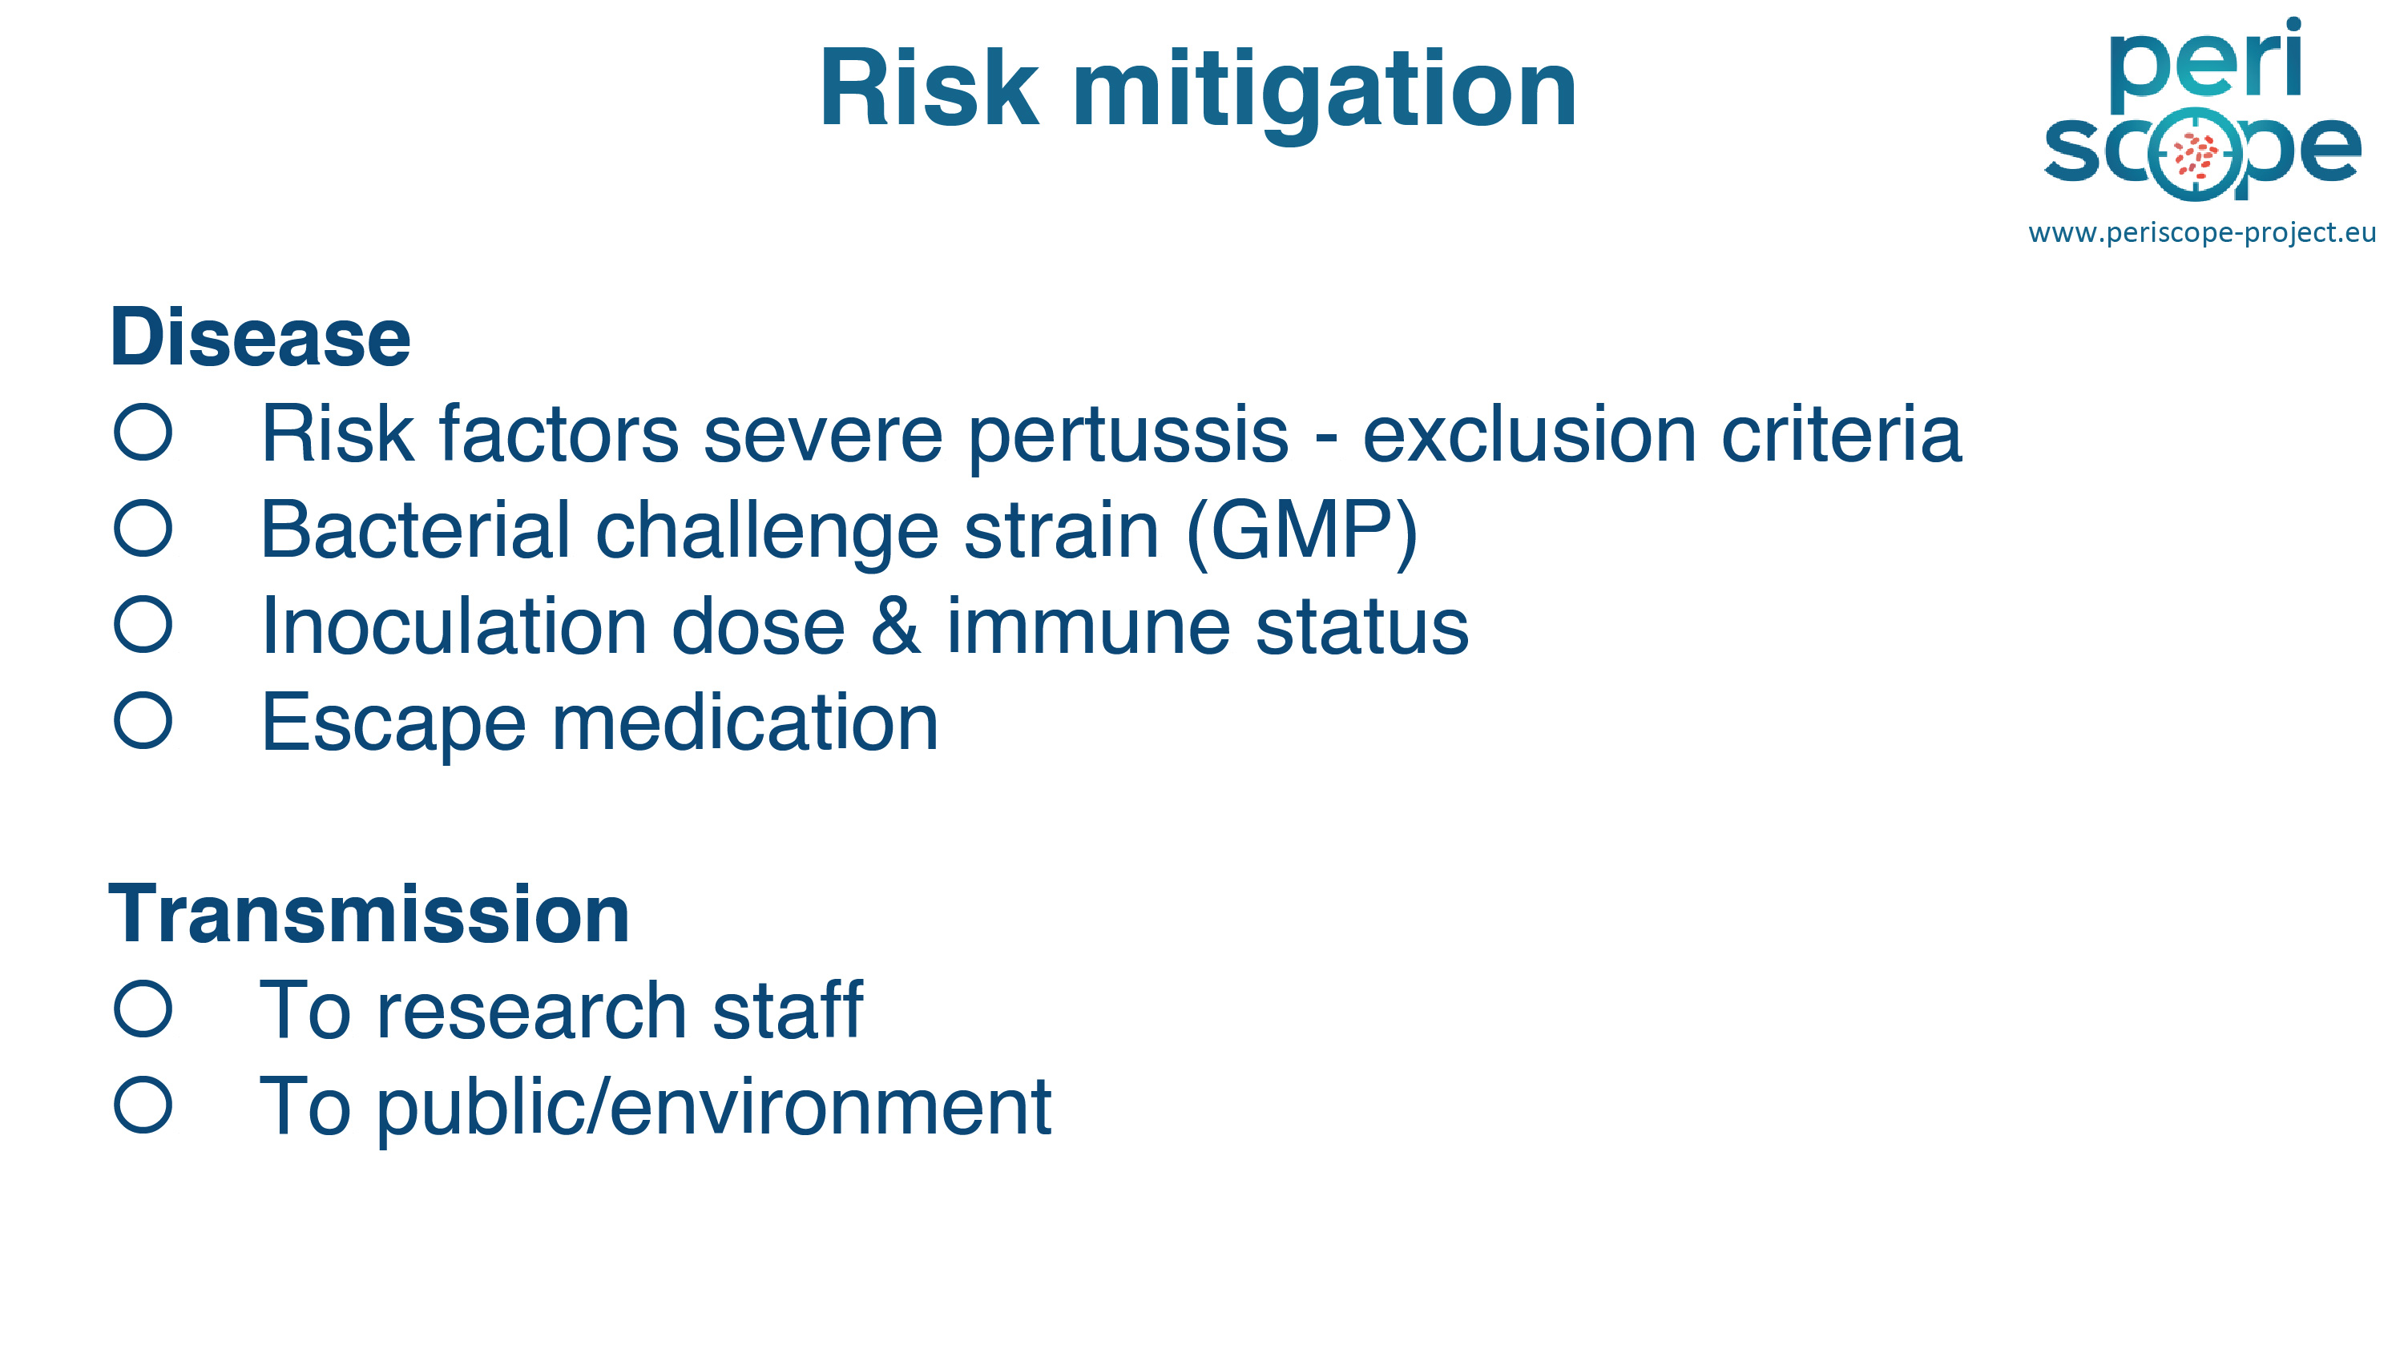

Slide 41
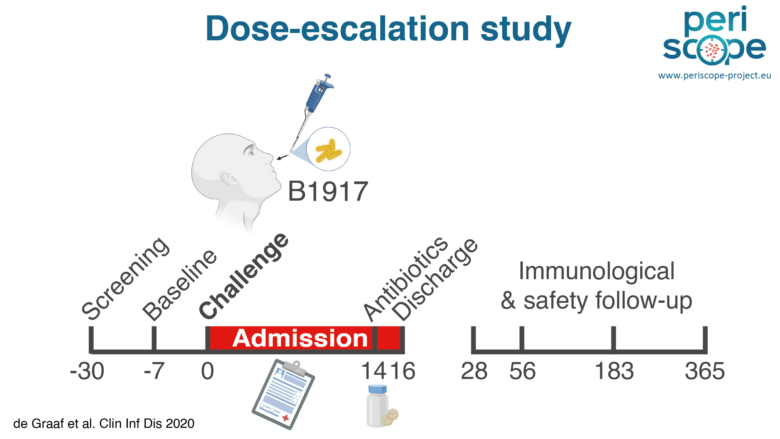

Slide 42
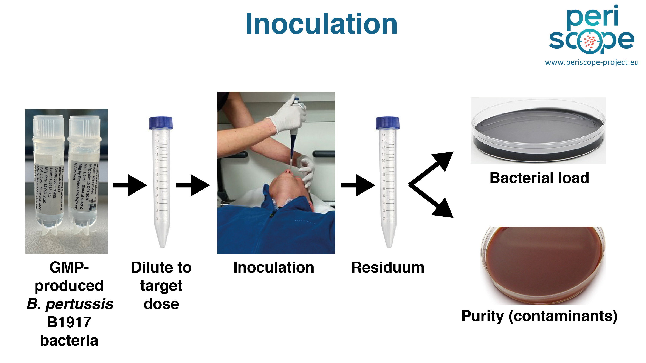

Slide 43
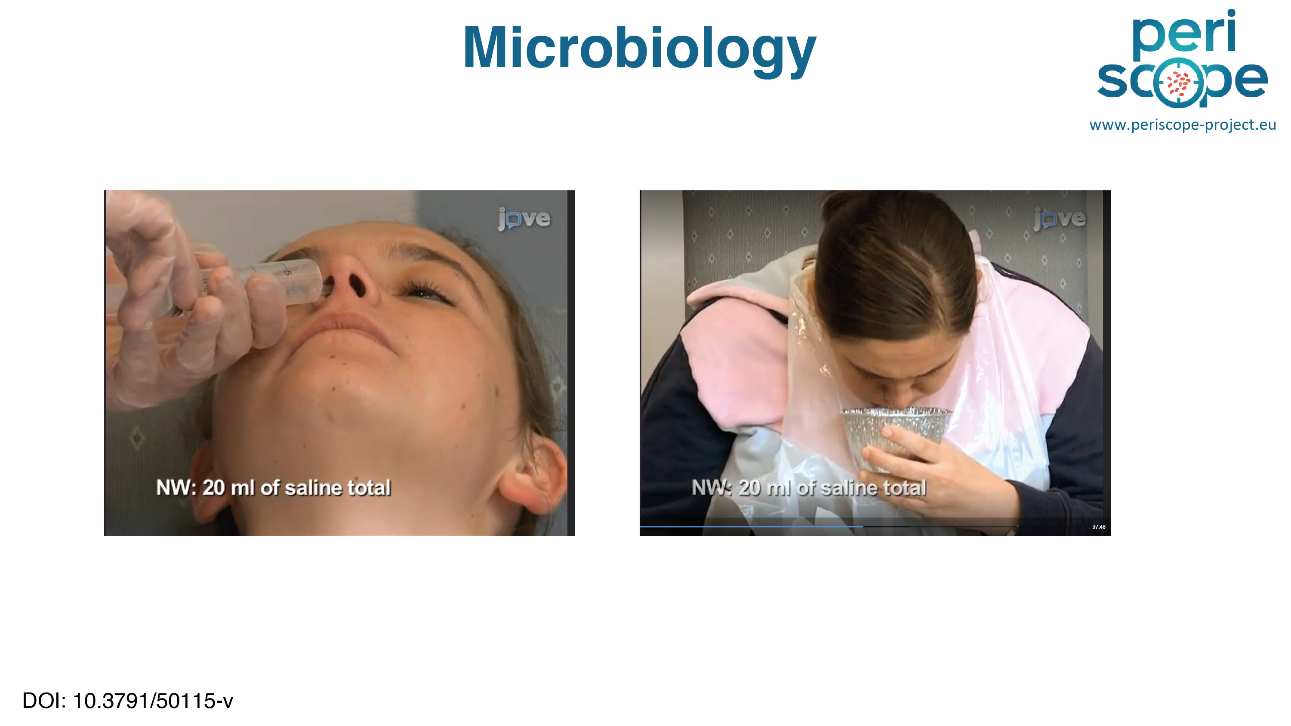

Slide 44
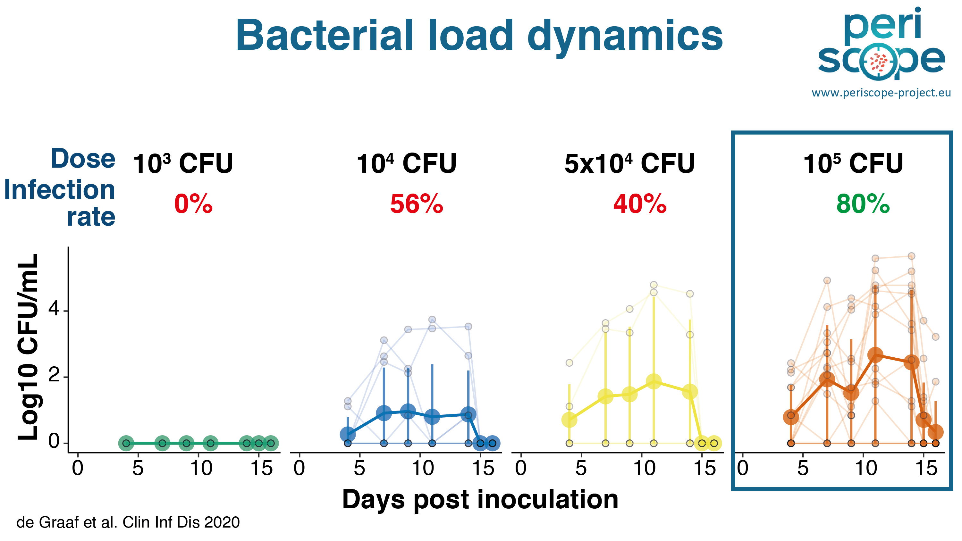

Slide 45
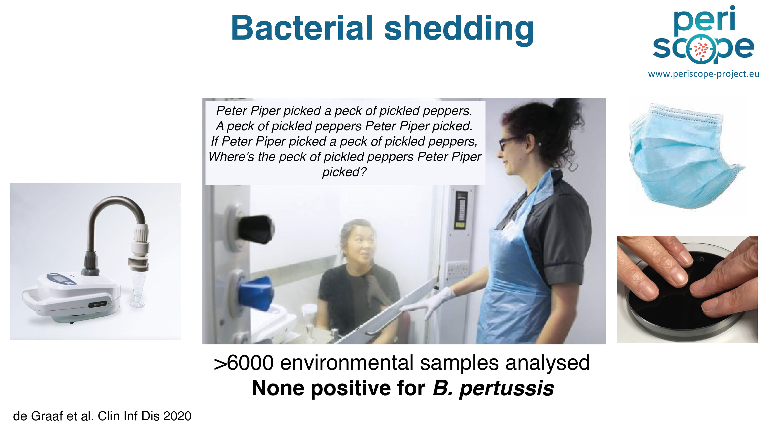

Slide 46
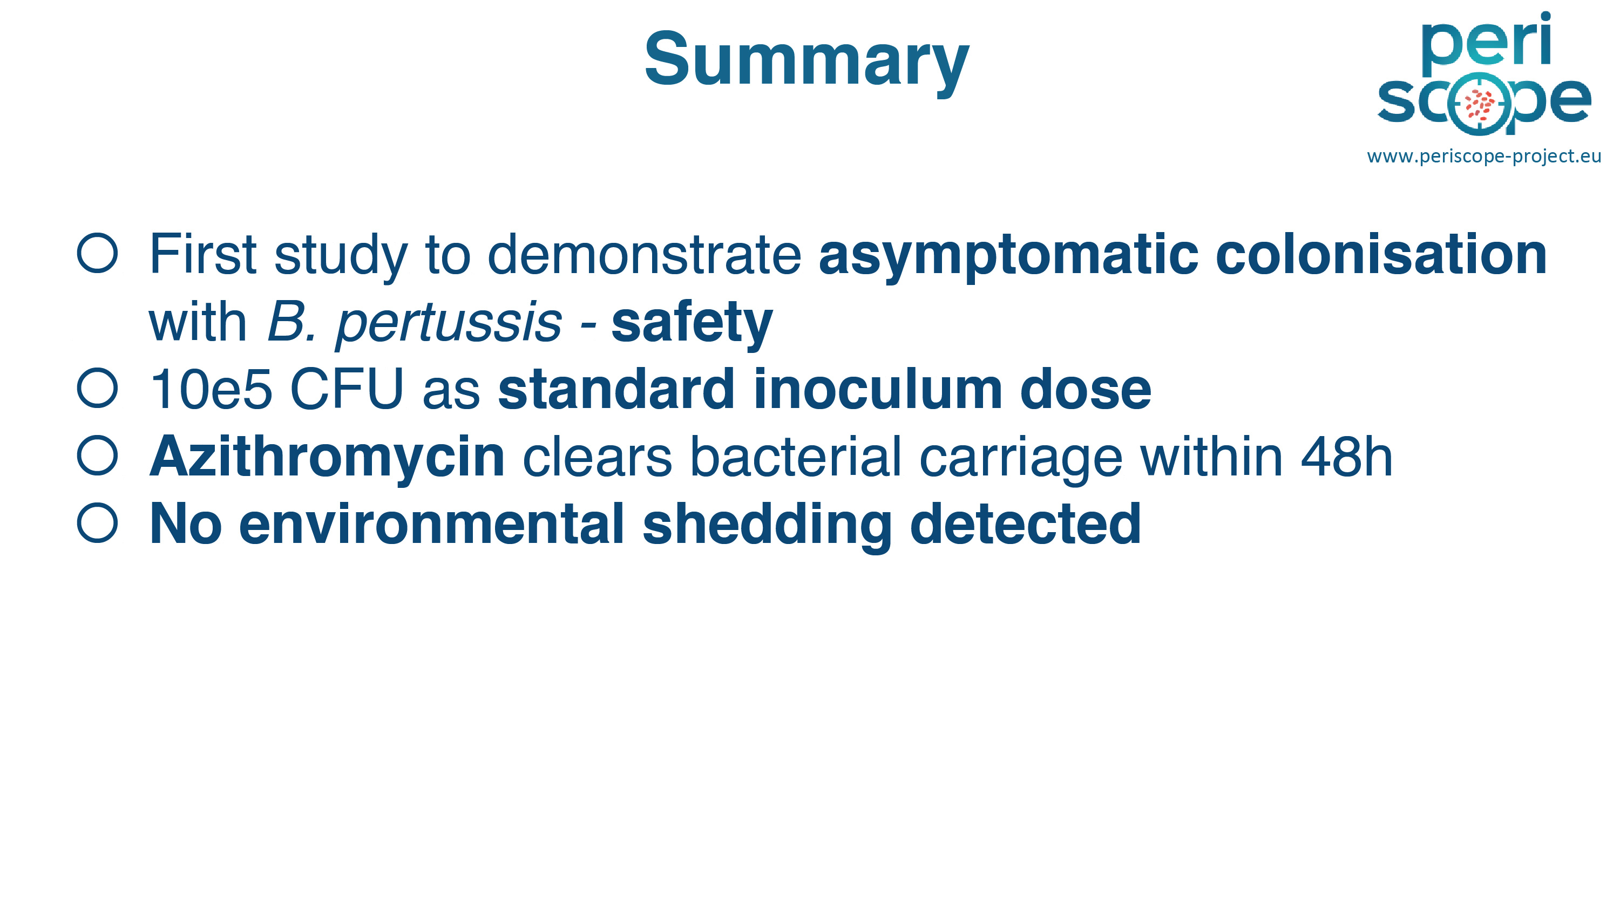

Slide 47
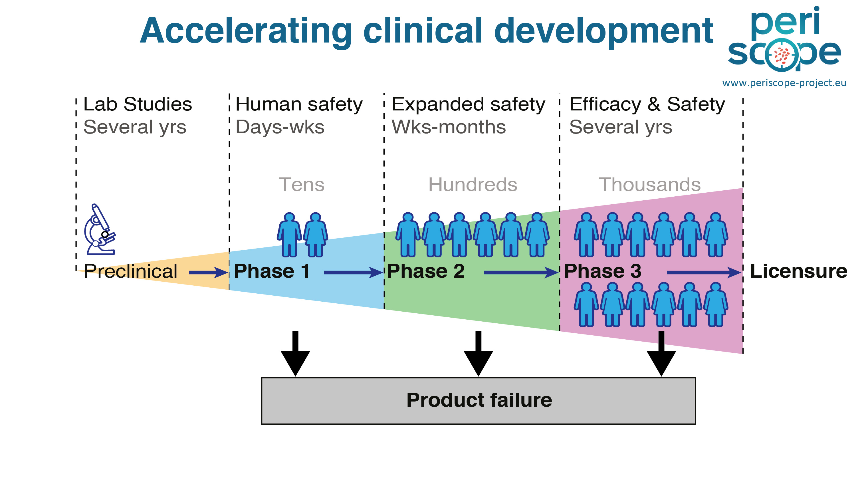

Slide 48
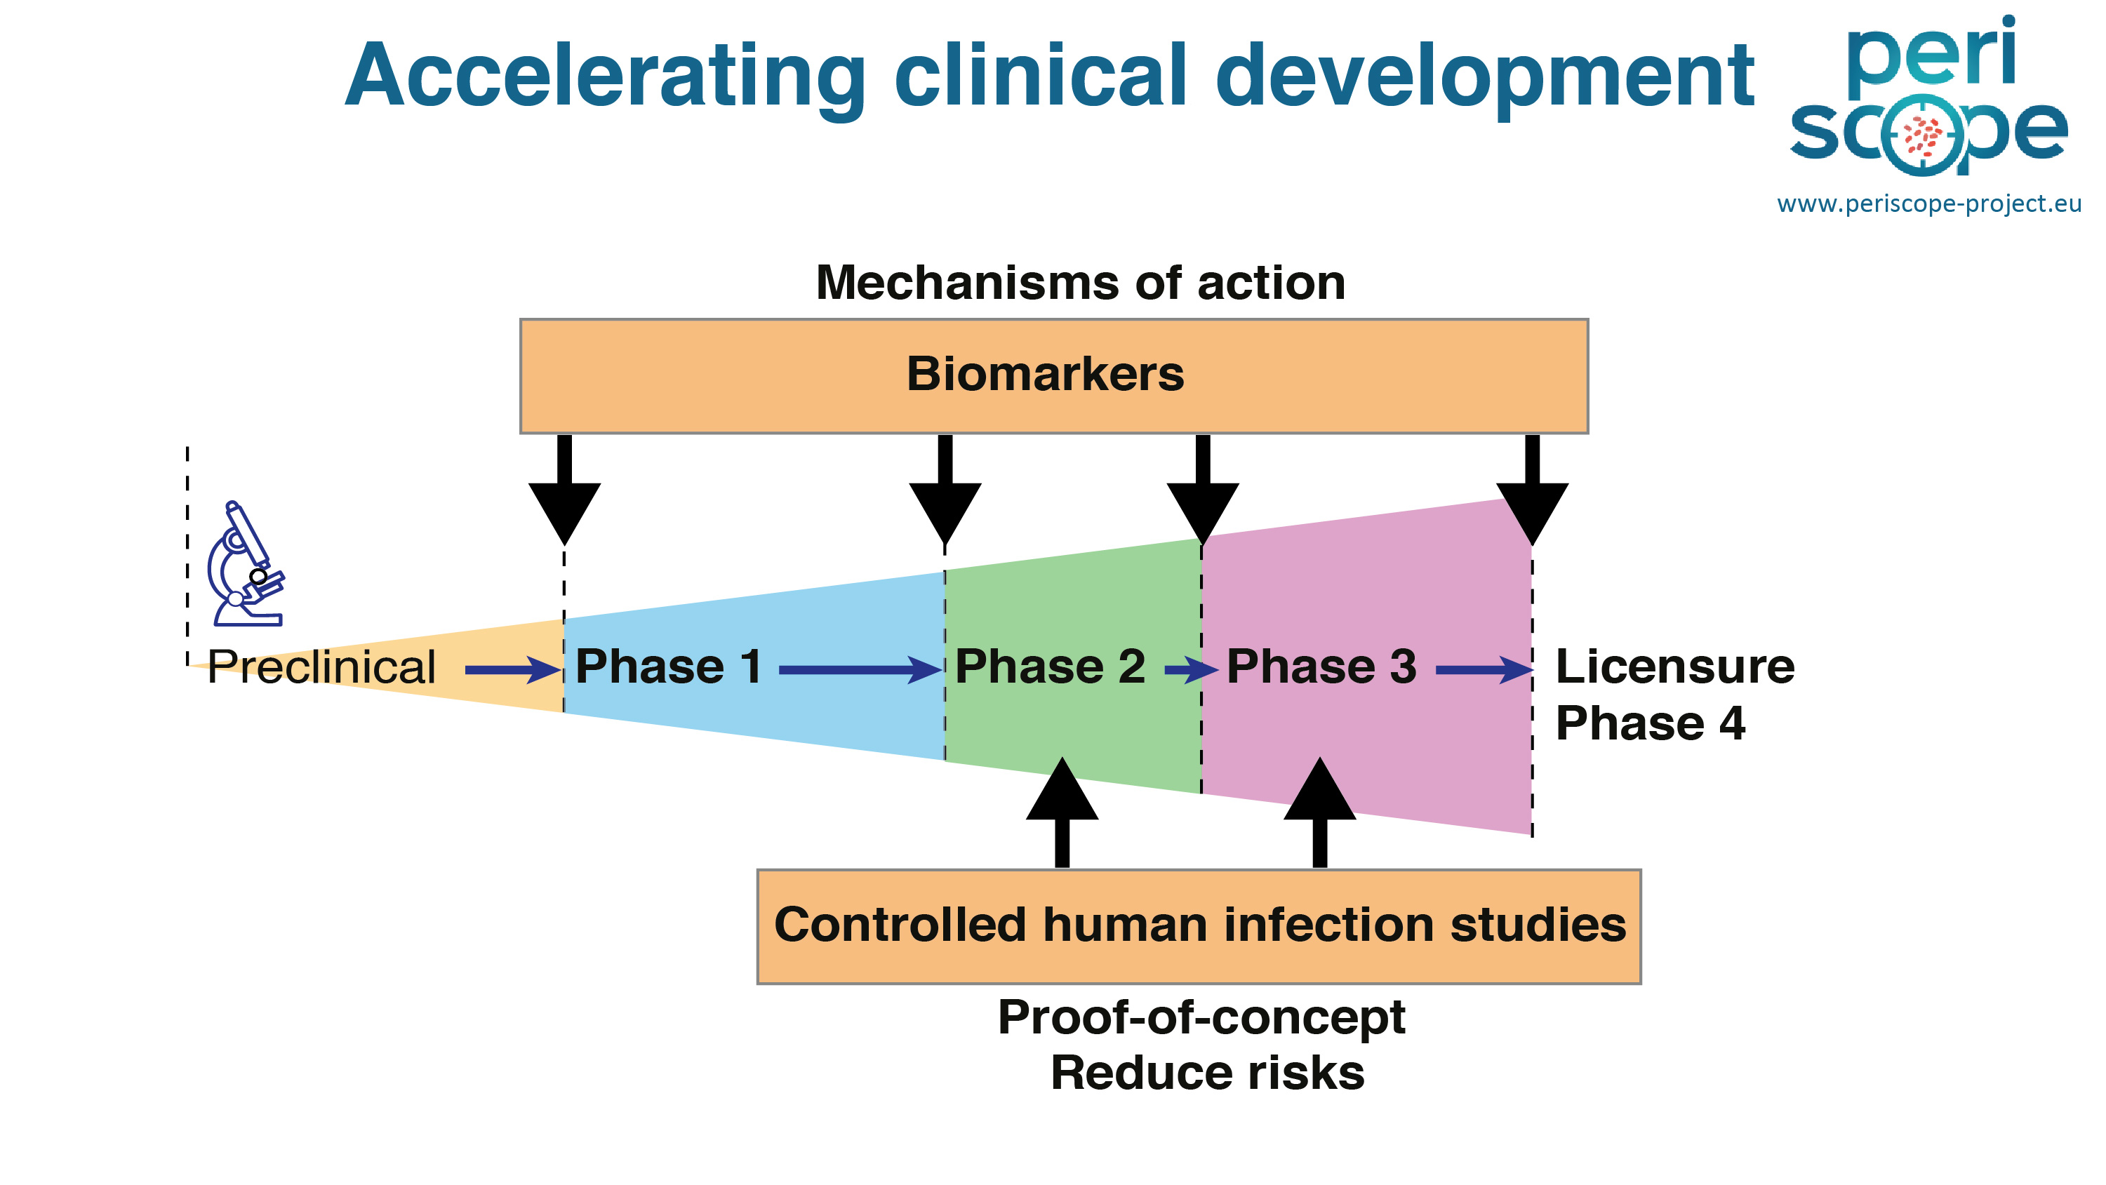

Slide 49
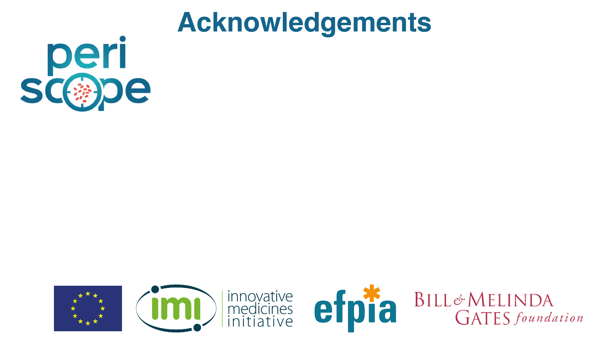
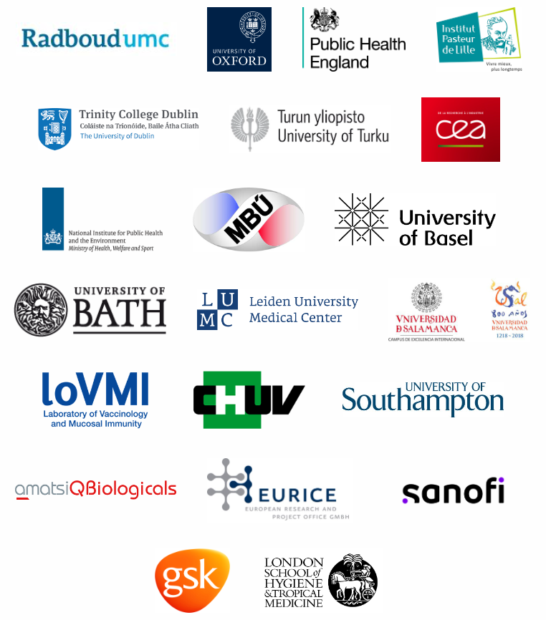
> Radboud University Medical Center (C)
> University of Oxford
> Public Health England
> Institut Pasteur de Lille
> Trinity College Dublin
> University of Turku
> CEA
> RIVM
> Institute of Microbiology of the CAS
> University of Basel Children’s Hospital
> University of Bath
> Leiden University Medical Center
> University of Salamanca
> Université Libre de Bruxelles
> Hospice Cantonaux
> University of Southampton
> Q-Biologicals NV (Eurofins)
> European Research and Project Office GmbH
> London School of Hygiene and Tropical Medicine
> Sanofi
> GSK Vaccines
All study participants!
Some images created with BioRender.com

Slide 50
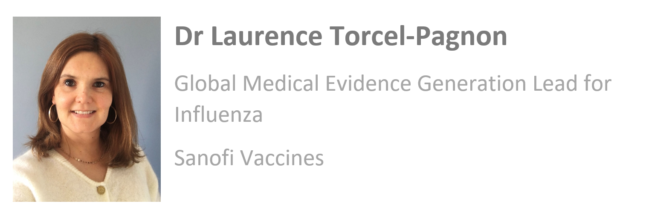

3. Once vaccine hits the market, how to perform vaccine effectiveness assessment ?

Slide 51
Innovative platform for Influenza vaccine effectiveness assessment: the value of collaboration across manufacturers and public sector
IMI impact on vaccines – How do IMI projects facilitate innovations in vaccine development and effectiveness assessment?
Webinar Nov 10th, 2023
Javier Diez-Domingo (FISABIO – DRIVE Coordinator) and
Laurence Torcel-Pagnon (Sanofi – DRIVE EFPIA lead)

Slide 52
Seasonal influenza in Europe
Every year
Influenza is usually mild, and most people recover quickly, but some people (like elderly, pregnant women, young children and people with underlying health conditions) are at high risk of serious complications, some of which can be life-threatening and result in death.
Despite the typically brief duration of symptoms and seasonal circulation of virus observed between November up to May in EU, influenza has a significant annual economic and healthcare burden.
Vaccination is the best way to prevent the disease. As influenza viruses change, vaccination against influenza is needed every year to keep up with the circulating viruses.
11% of the population affected
(50 million of flu cases detected)¹
15,000–70,000 dealths¹
€6-14 billion of direct and indirect costs²
12 influenza vaccines with different technologies for different population groups³
[1] ECDC. European Centre for Disease Prevention and Control Factsheet for health professionals. Available from: http://ecdc.europa.eu/en/healthtopics/seasonal_influenza/basic_facts/Pages/factsheet_professionals_seasonal_influenza.aspx. [Accessed 7 July 2022]
[2] Preaud, E., Durand, L., Macabeo, B. et al. Annual public health and economic benefits of seasonal influenza vaccination: a European estimate. BMC Public Health 14, 813 (2014). https://doi.org/10.1186/1471-2458-14-813
[3] on the market for 2021-2022 season

Slide 53
Combining EU efforts to assess vaccines performance
Monitoring vaccine performance after regulatory approval and immunization programme implementation is critical for guiding health authorities.
Generating real-world evidence (RWE) to assess the benefit/risk of their marketed vaccines is an obligation for vaccines companies.
Joint mandate
Substantial challenge to provide robust vaccine monitoring estimates in real-life conditions and account for the diversity and heterogeneity observed in Europe on virus circulation, vaccines technology and uptake, populations, and settings.
Complexe real-world environnement

Slide 54
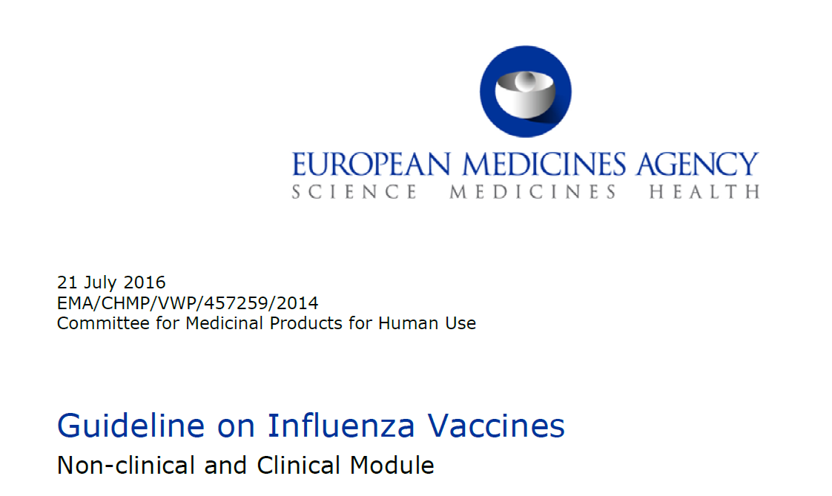

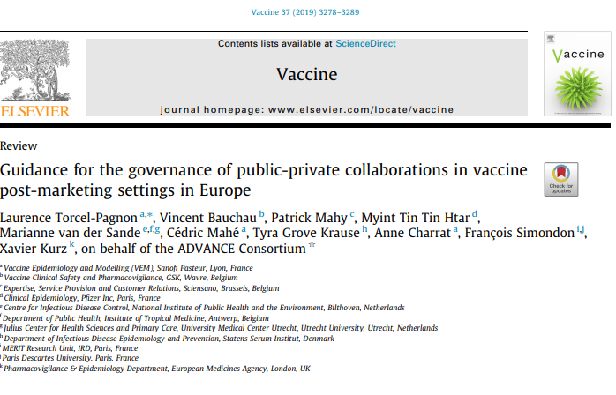
DRIVE project
Proof-of-concept of the EMA Influenza vaccines guidance
  public-private multi MAHs partnership answering to a regulatory commitment
  -> test the governance and regulatory pathway
  Platform to provide yearly brand-specific influenza vaccine effectiveness
  -> test the feasibility to get robust estimates for all ages/settings/brands in EU
5-years (2017-2022) 10 M€ project
    16 partners from 7 European countries, coming from public health institutes, universities, research institutes, small-medium enterprises, patients’ associations, and vaccine companies
    leveraging ADVANCE project outputs (governance framework for collaboration in post marketing setting) set up as H1N1 influenza pandemic

Slide 55
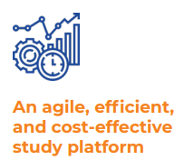

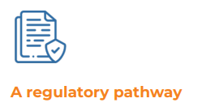


DRIVE key achievements
Large study platform (13 sites, 21 hospitals, > 1,000 general practices in 7 EU countries and 1 nationwide population-based cohort, in Finland
Common protocol, pooled analysis
Results delivered 2 months after end of season
Leveraging public health capacities and public-private funding
Multi-stakeholder scientific collaboration, annual forum
Transparent review process on the protocol and results by all partners with an Independent Scientific Committee oversight: independent study conduct and scientific committee for results interpretations
High-quality data standards
MAHs joint report for annual brand–specific influenza vaccines effectiveness estimates and EMA Vaccine working party evaluations
5 influenza seasons including >35,000 severe acute respiratory infection patients, and 13 influenza vaccines
In 2019/20 season, 3 precise brand specific IVE in specific settings/populations (95% CI width<40%)
In the 2021/22 season, 8 out of 12 of influenza vaccines captured
Seasonal results posted online
Scientific communications and awareness campaigns: 73 website posts, 34 event participations, 26 newsletters and 21 publications

Slide 56
DRIVE limitations and conclusion
Despite focus on populations with highest disease burden of influenza and relatively high vaccine coverage (elderly in hospital setting) and adjusted parsimonious approach for pooled analysis, it remains a challenge to get precise estimates on several brands for informed decision making
EMA deemed the data insufficient for decision making (request to have serial annual estimates obtained over minimum of 3 years)
Public-private partnership hesitancy and parallel public-only initiative remains an obstacle for the scale up of RWE collaborative platforms which should be tackled more broadly by EU and national institutions.
The platform was unique in offering consistently brand-specific IVE results for each season in the EU
Successful proof-of concept that deserves continuation but needs clarity on stakeholders' roles and responsibilities on vaccine monitoring at the EU level before further action

Slide 57


Beyond DRIVE
DRIVE sustainability
Encouraging data sharing practices (secondary use framework for DRIVE database)
Joining efforts to tackle COVID-19 pandemic: COVIDRIVE set up in record time leveraging DRIVE components
Still on-going discussion with EMA
The lessons learned from DRIVE will be taken into account during the ongoing revision of the influenza guideline (consultation planned in Q4 2023)
A public-private partnership for the estimation of brand-specific COVID-19 vaccine effectiveness in Europe

Slide 58



Thanks to the DRIVE community!
Study platform
Website: Home - DRIVE (drive-eu.org)
End project publication: Diez-Domingo J, et al. Experts review of Vaccines. 2022; DOI: 10.1080/14760584.2022.2137144

Slide 59

Q&A time
Use the chat below to ask questions to the speakers

Slide 60
Thank you for your attention
ihi.europa.eu

